Slide 1
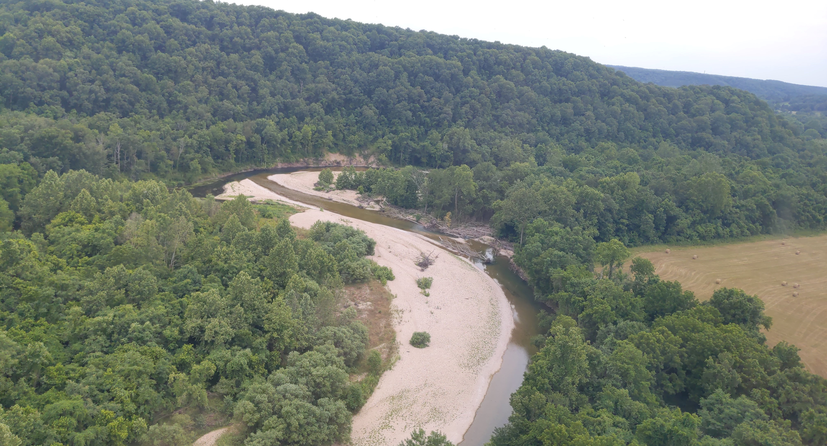
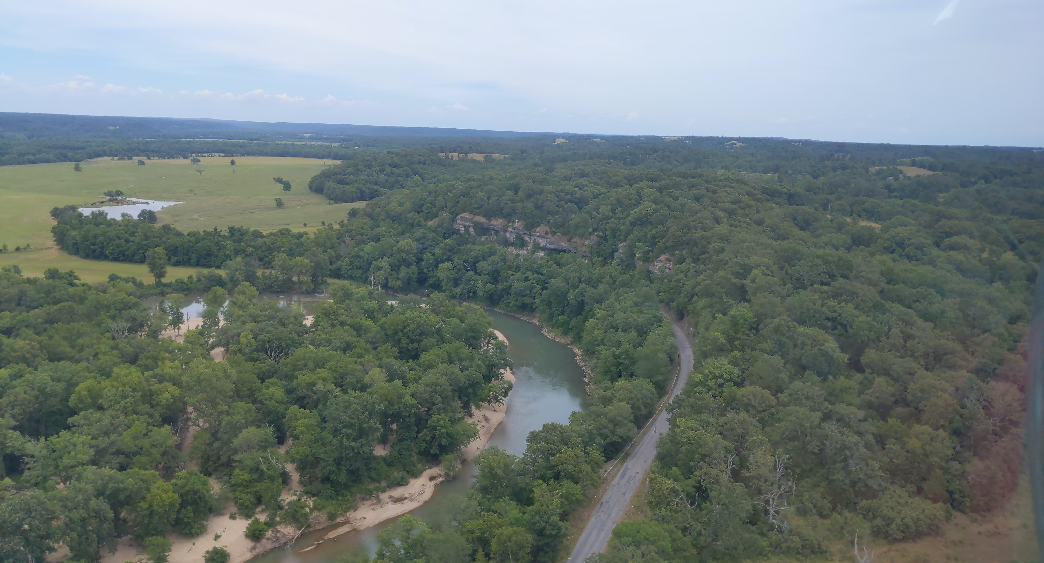
Hydrologic analysis of the Illinois River basin in Arkansas and Oklahoma
Public Release
April 11, 2023

Slide 2
Study partners and federal authority
U.S. Army Corps of Engineers functions as a technical arm of Congress
Everything the U.S. Army Corps of Engineers does is authorized and appropriated through legislation
Recurring authorizations exist to partner with local tribes, communities, municipalities to provide Federal assistance.
Partnership with the Cherokee Nation through the recurring “Planning Assistance to State” authority to:
  Identify the major contributing factors to increased water levels in the Illinois River Basin
  Evaluate suggestions to decrease the frequency and magnitude of flooding
  Supply data, models, information to assist in the communication of and understanding of flood risk for more localized planning entities to leverage.
  The study focuses on investigating data looking to the future and NOT full forensics on the past (circa 1990 to present)
  The study was conducted at a broad watershed level (not individual parcels) to provide a deeper understanding of conditions and to generate consistent datasets for use in planning by local level authorities.
  Corps of Engineers is NOT building dams or anything in the Illinois River Watershed.

Slide 3
bluf
Not trying to unravel the past but trying to understand how to plan for the future
This information will be used for planning purposes- information to better understand flood risk so that local planners can divide and conquer in their area
Scenarios were simulated to understand the some best management practices at a 30,000 ft view, at a watershed scale
There is localized impact of flooding from urbanization, however we looked at it from a watershed scale, not a really small, local scale
Increase in precipitation, increase in urbanization in NW AR and land-use change along the River in OK – All contributions to flooding with the largest being the increase in precipitation

Slide 4
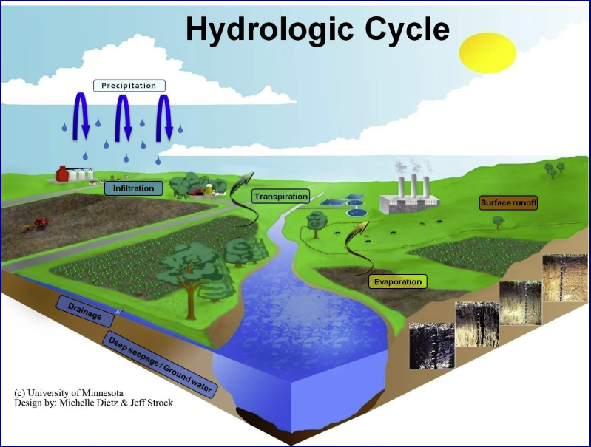
Hydrology vs hydraulics
HYDROLOGY is translating precipitation to streamflow
HYDRAULICS is translating streamflow to elevation

Slide 5
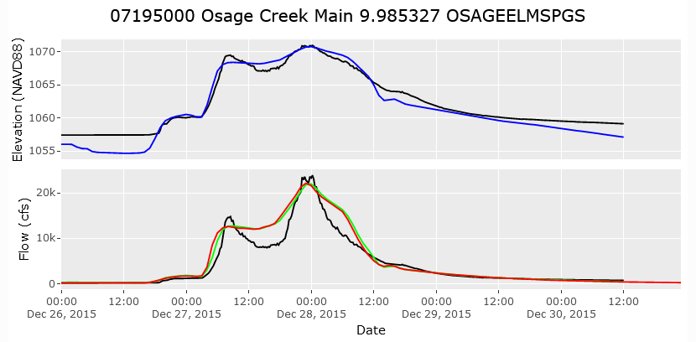
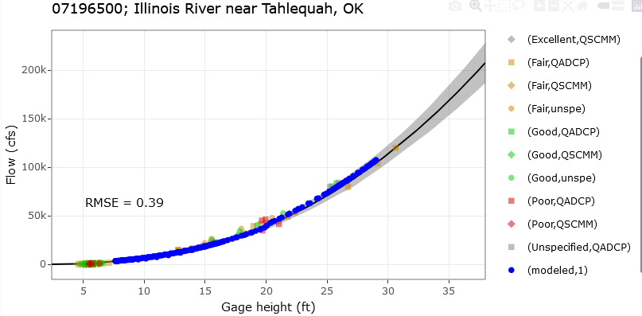
Data & Models
Land-Use Data
Precipitation Data
Streamgage Data
Elevation Data
Statistical Models
Land-Use Model
Hydrologic Model
Hydraulic Model

Slide 6
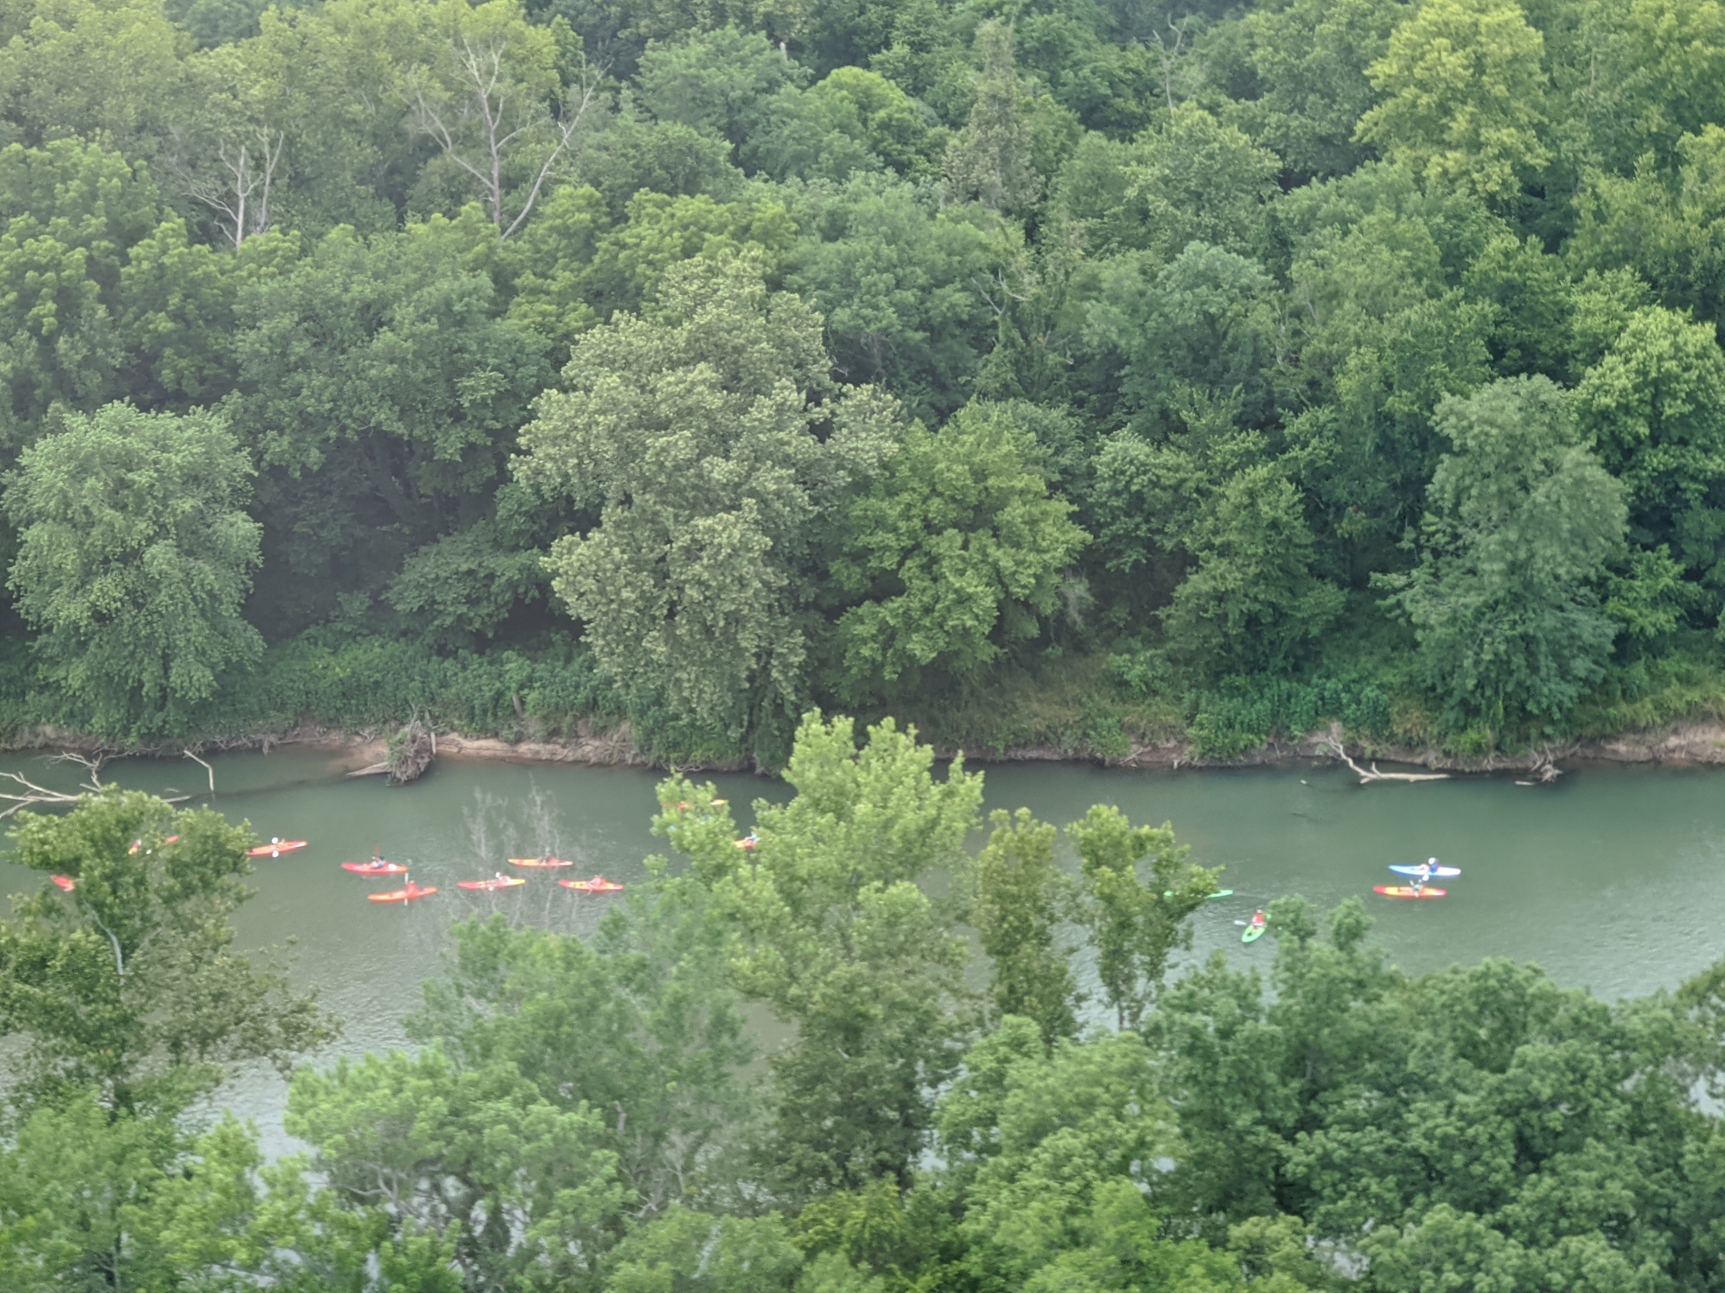
Outline
Precipitation Trends
Land-Use Trends
Streamflow Trends
Scenarios
  Precipitation
    NOAA Atlas 14 Frequency Events
  Land use
    NLCD Historical
    Future
  Detention basins
  Riparian Buffers

Slide 7
Gage Locations

Slide 8
Precipitation trends

Slide 9
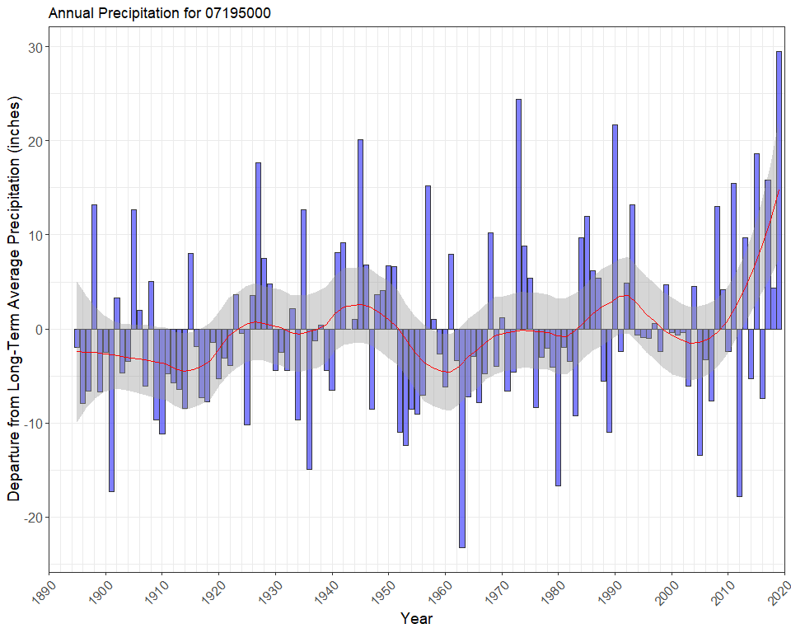
Osage Creek near Elm Springs, AR
PRISM Climate Group

Slide 10
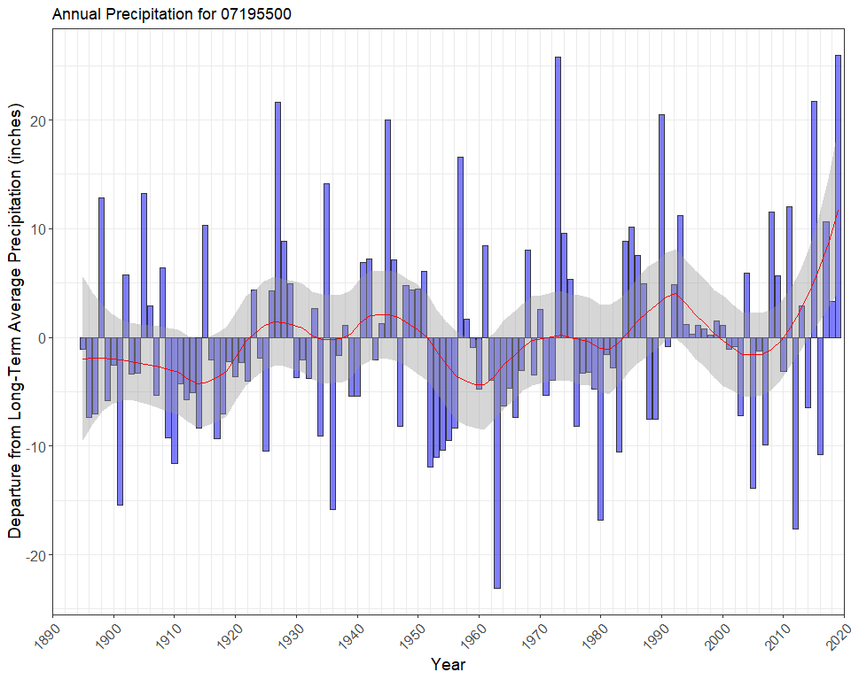
Illinois River near Watts, OK
PRISM Climate Group

Slide 11
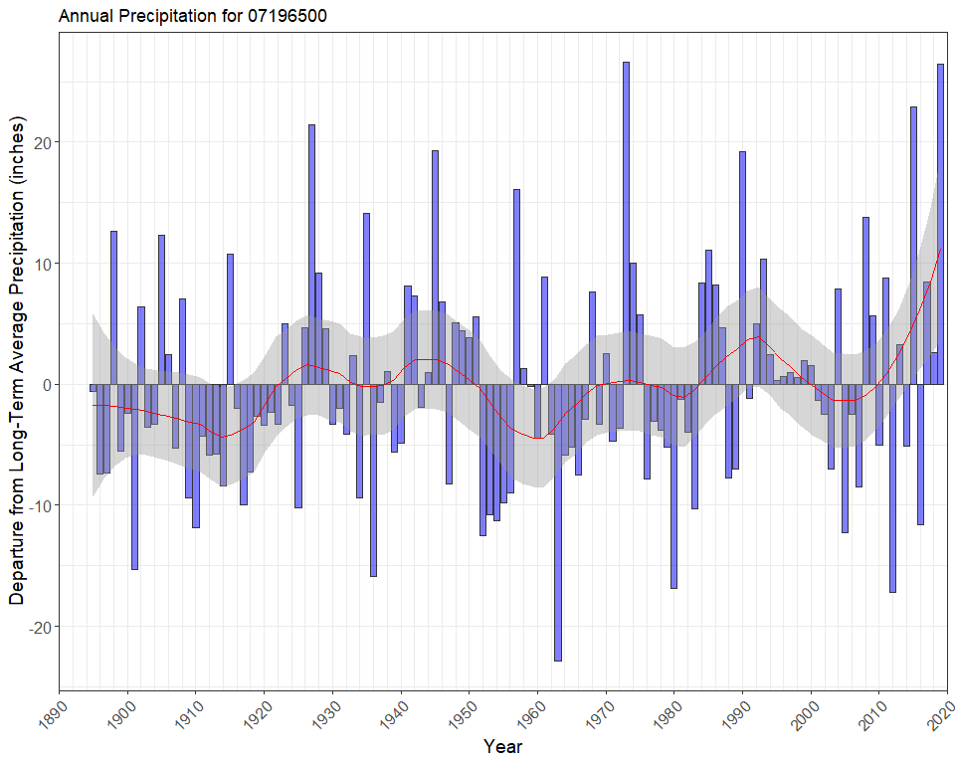
Illinois River near Tahlequah, OK
PRISM Climate Group

Slide 12
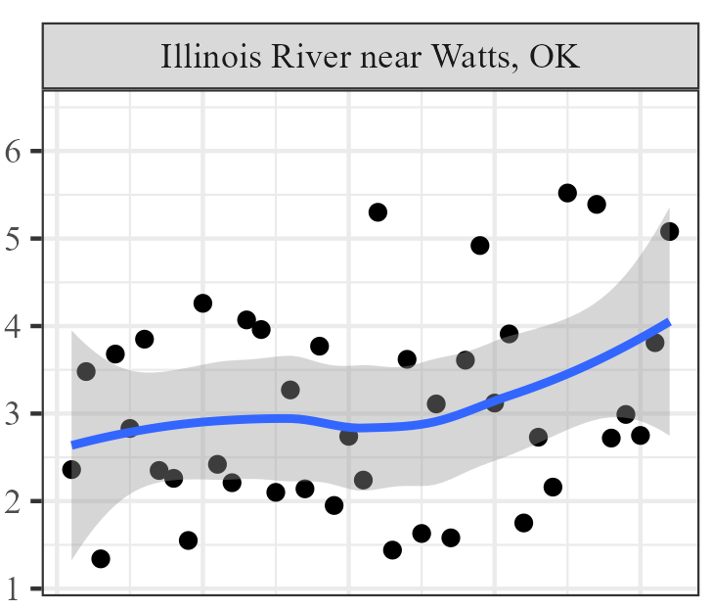
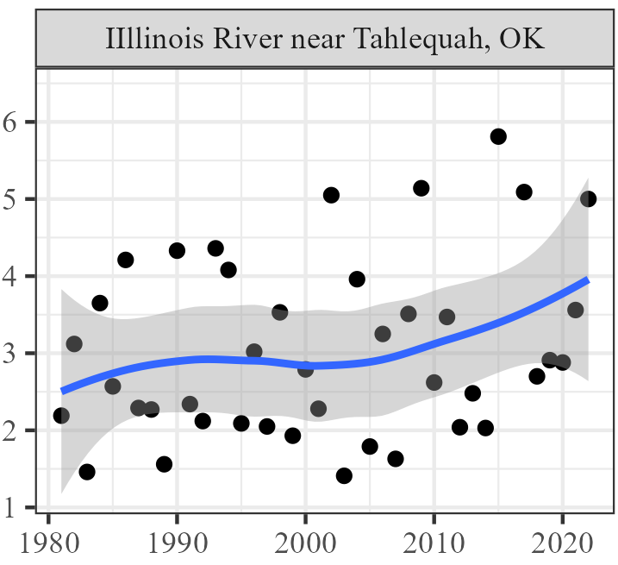
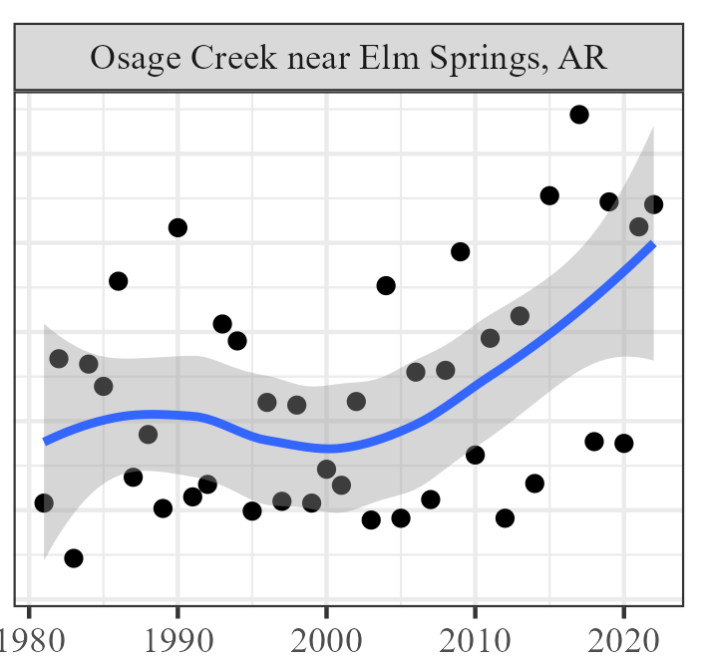


Precipitation magnitude – 24-hour
PRISM Climate Group

Slide 13
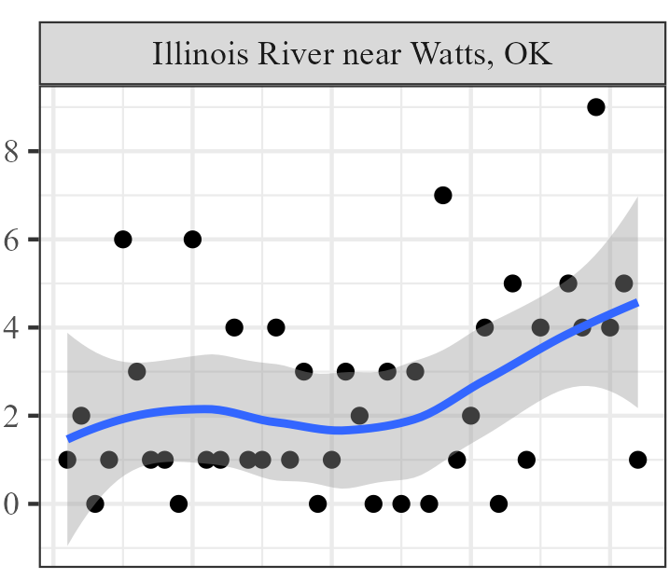
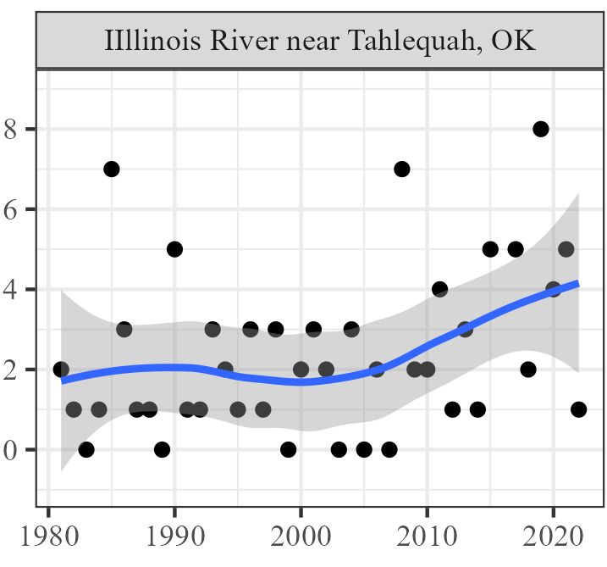
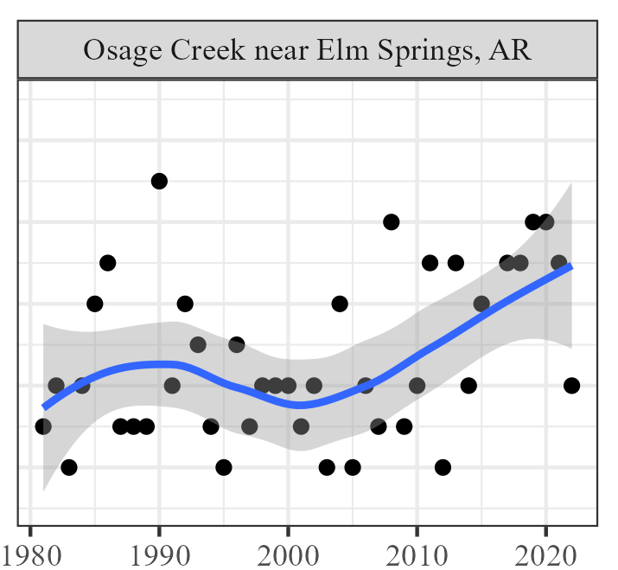
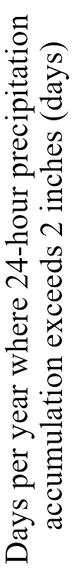
Precipitation intensity– 24-Hour
PRISM Climate Group

Slide 14
Land-use trends

Slide 15
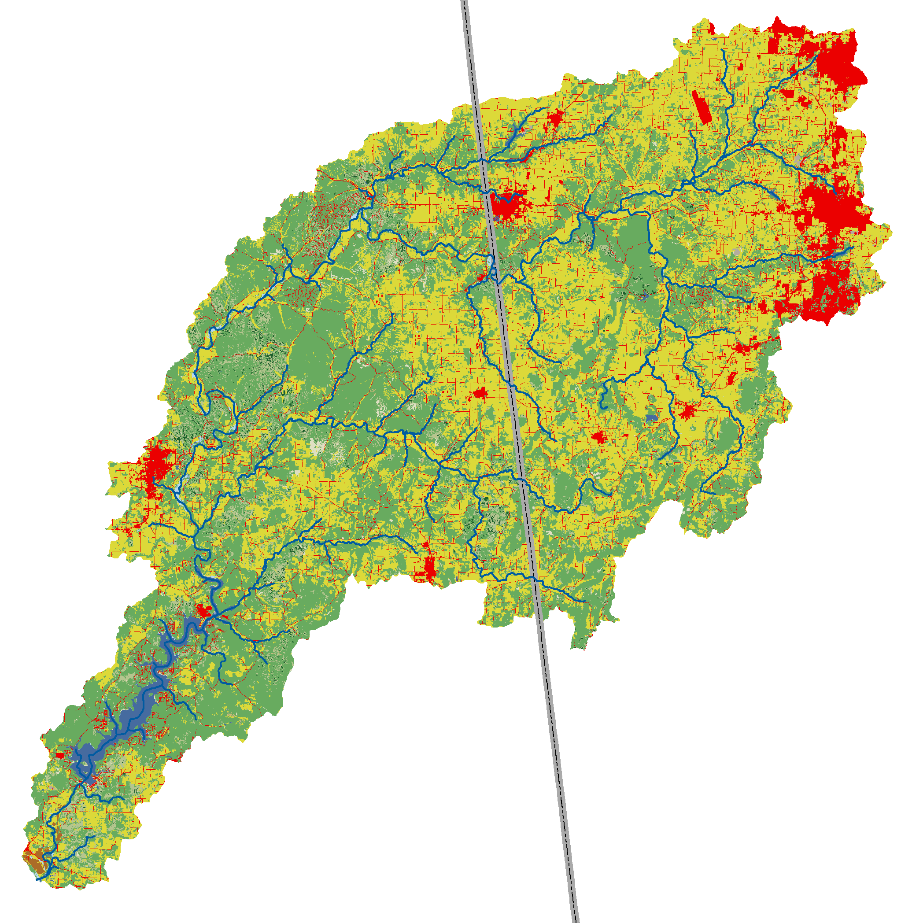
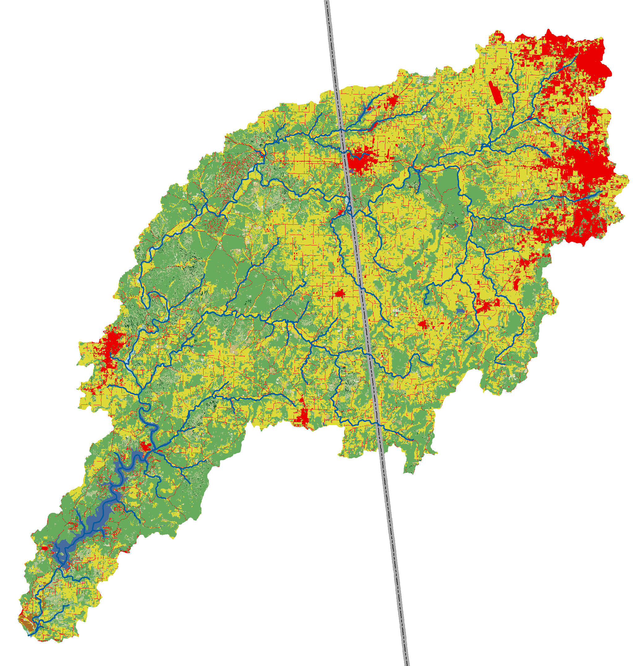
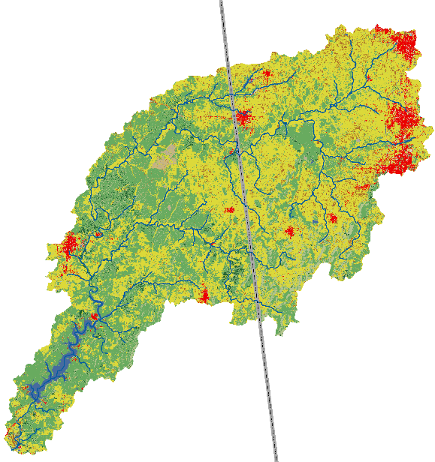
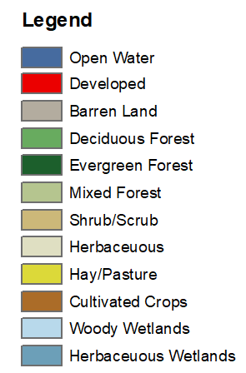
Land-Use trends
1992 Land use land cover
2001 Land use land cover
2016 Land use land cover
National Land Cover Database (NLCD)

Slide 16
Land-Use trends
1992 = 62.2 mi²
2001 = 142.6 mi² = 129.3% increase
2016 = 170.7 mi² = 19.7% increase

Slide 17
Streamflow trends

Slide 18
Streamflow Trends

Slide 19
Streamflow Trends

Slide 20
Streamflow Trends

Slide 21
Streamflow Trends

Slide 22
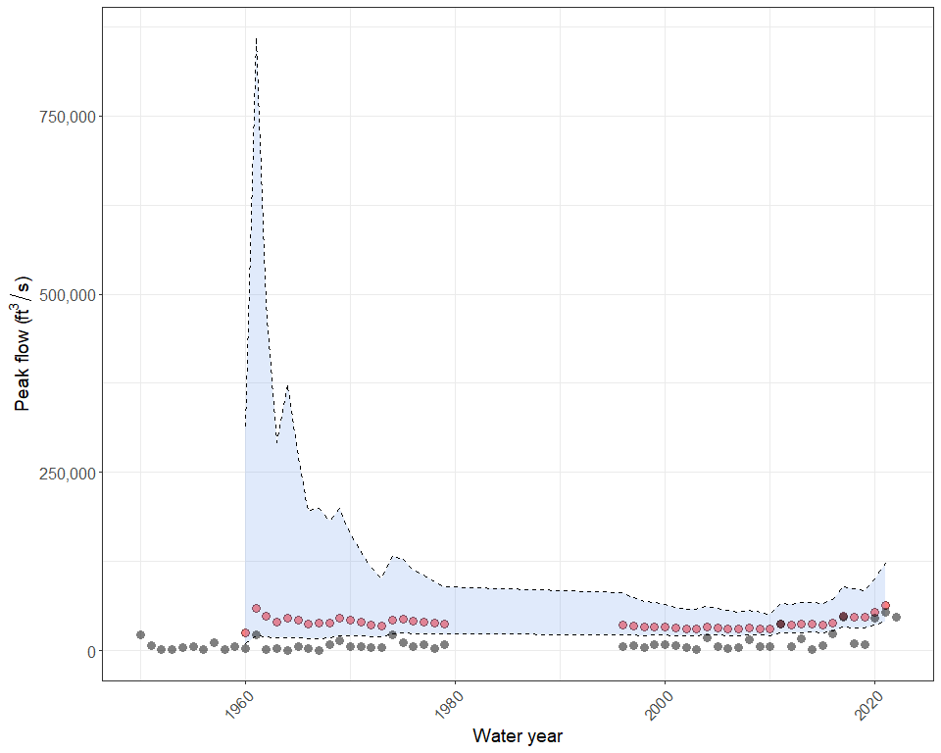
1% AEP(100-year) Flow Change Over Time
Osage Creek near Elm Springs, AR
Current 1% AEP Estimate
Computed 1% AEP Flow
125,000
Confidence Limits
Peak flow (ft³/s)
0
2000
2010
2020
Observed Annual Peak Flows

Slide 23
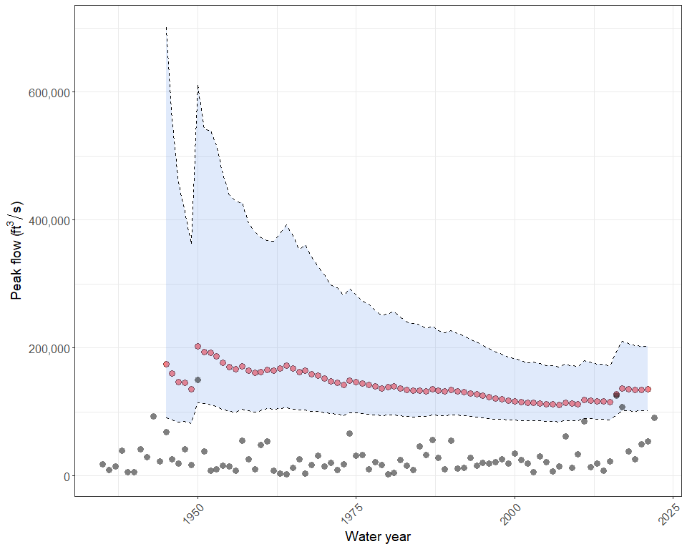
1% AEP(100-year) Flow Change Over Time
23
Illinois River near Tahlequah, OK
Computed 1% AEP Flow
Current 1% AEP Estimate
200,000
Peak flow (ft³/s)
Confidence Limits
100,000
0
Observed Annual Peak Flows
2000
2012
2025

Slide 24
scenarios

Slide 25
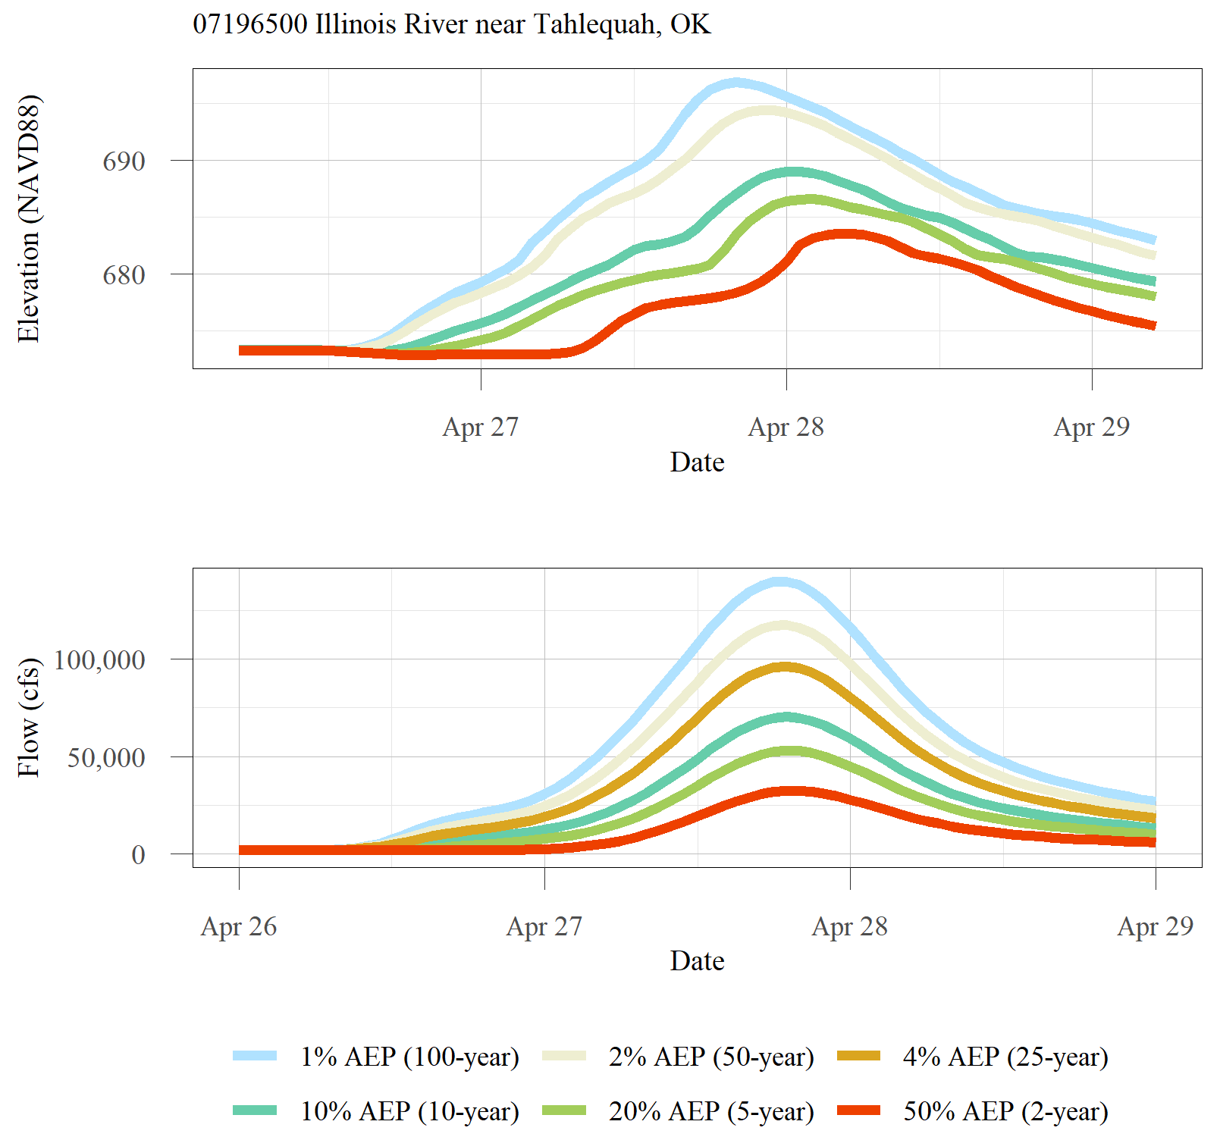
Precipitation Scenarios
Event | 24-Hour Precipitation Amount (inches)
50%AEP (2-year) | 3.76
20%AEP (5-year) | 4.71
10%AEP (10-year) | 5.48
4% AEP (25-year) | 6.57
2% AEP (50-year) | 7.45
1% AEP (100-year) | 8.37
NOAA Atlas 14 Point Precipitation Frequency Estimates
2017

Slide 26
Land-use Scenarios
1992
2001
2050 B2
2016
2050 A1B
National Land Cover Database – USGS Earth Resources Observation and Science (EROS) Center

Slide 27
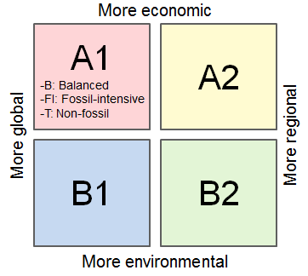
Land-Use Scenarios
75% less developed
B2
A1B
IPCC Special Report on Emissions Scenarios (SRES) Definitions:
A1B – Very rapid economic growth, global population that peaks in mid-century and declines thereafter, and the rapid introduction of new and more efficient technologies with a “balance” across all energy sources, i.e., not relying too heavily on one particular energy source
B2 – Emphasis is on local solutions to economic, social, and environmental sustainability; continuously increasing global population at a slower rate than other scenarios, intermediate levels of economic development, and less rapid and more diverse technological change

Slide 28
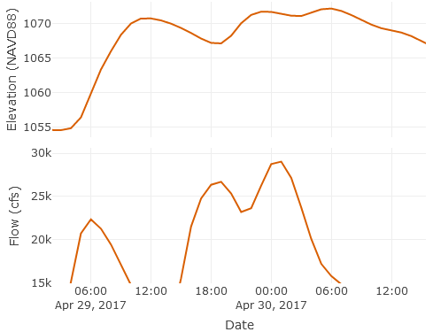
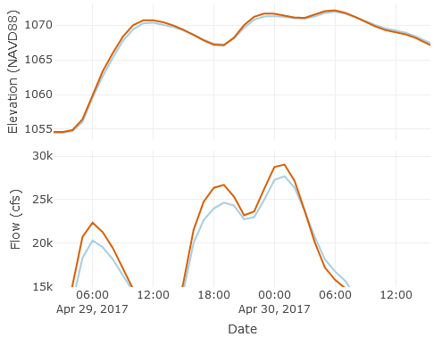
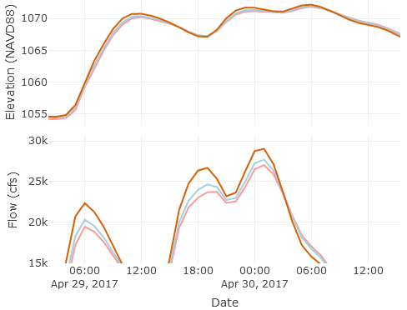

Historical Land-use
2017
1990

Slide 29
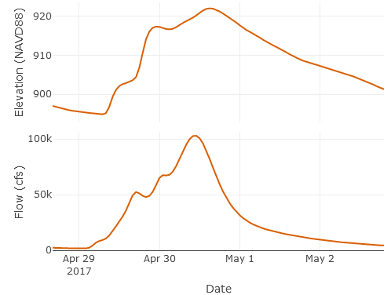
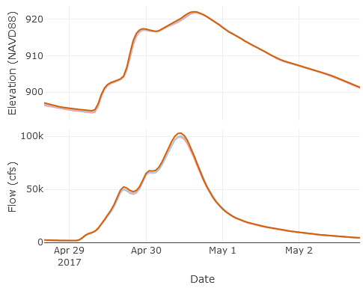

Historical Land-use
2017
1990

Slide 30
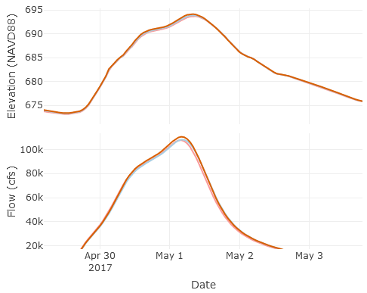
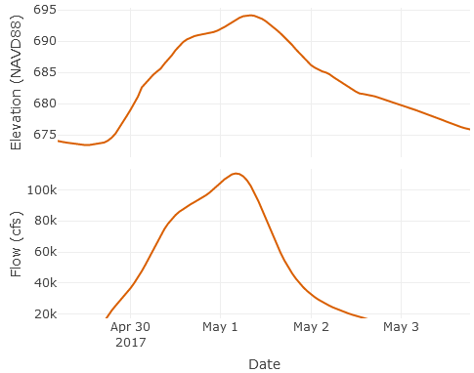
Historical Land-use
2017
1990

Slide 31
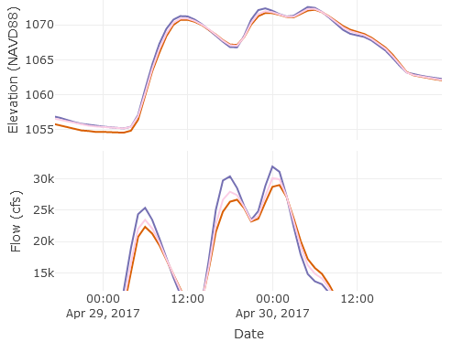
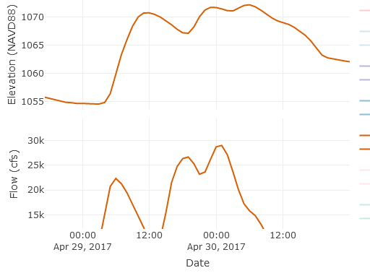
Future Land-use projections – no stormwater management considered
2017
2050 B2
2050 A1B

Slide 32
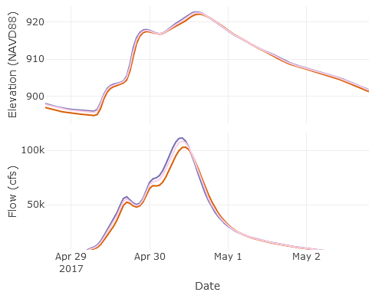
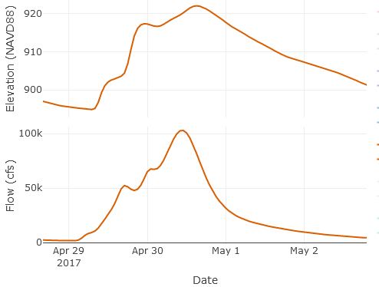
Future Land-use projections – no stormwater management considered
2017
2050 B2
2050 A1B

Slide 33
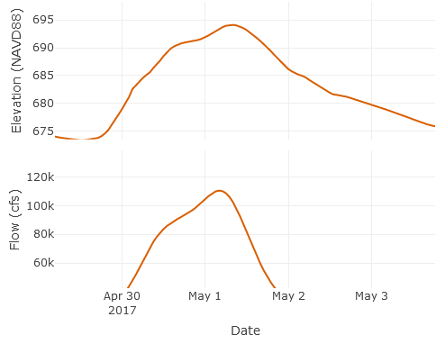
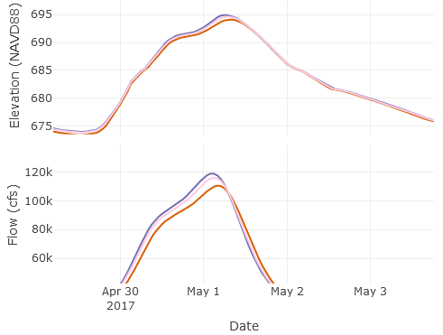
Future Land-use projections – no stormwater management considered
2017
2050 B2
2050 A1B

Slide 34
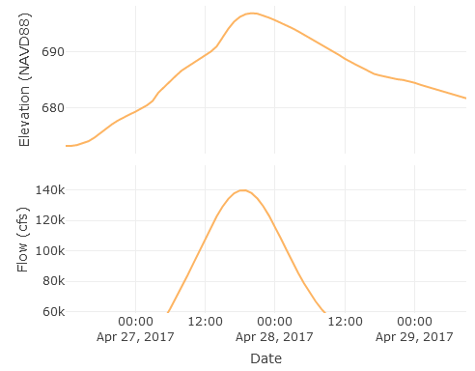
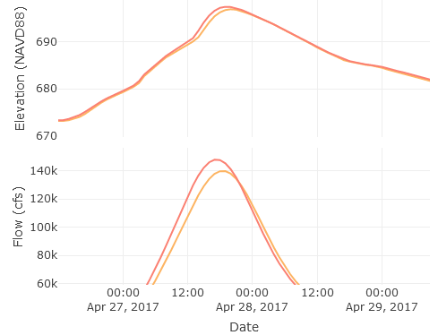
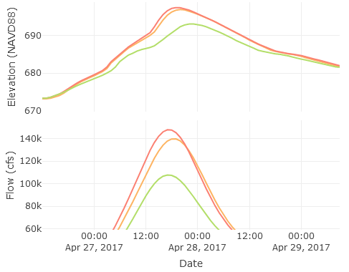

Detention basins – Not recommended
2017
2050 B2
2050 A1B

Slide 35
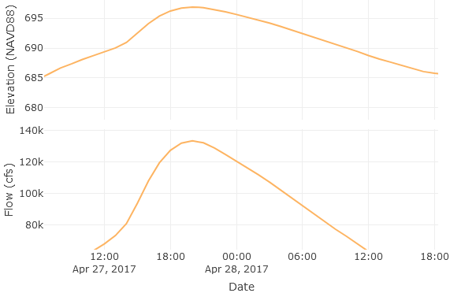
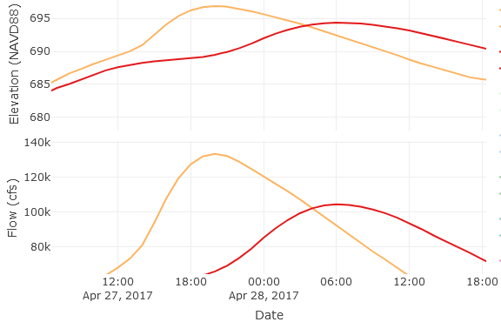
Riparian buffers – 1%AEP (100-Year)
2017
2050 B2
2050 A1B

Slide 36
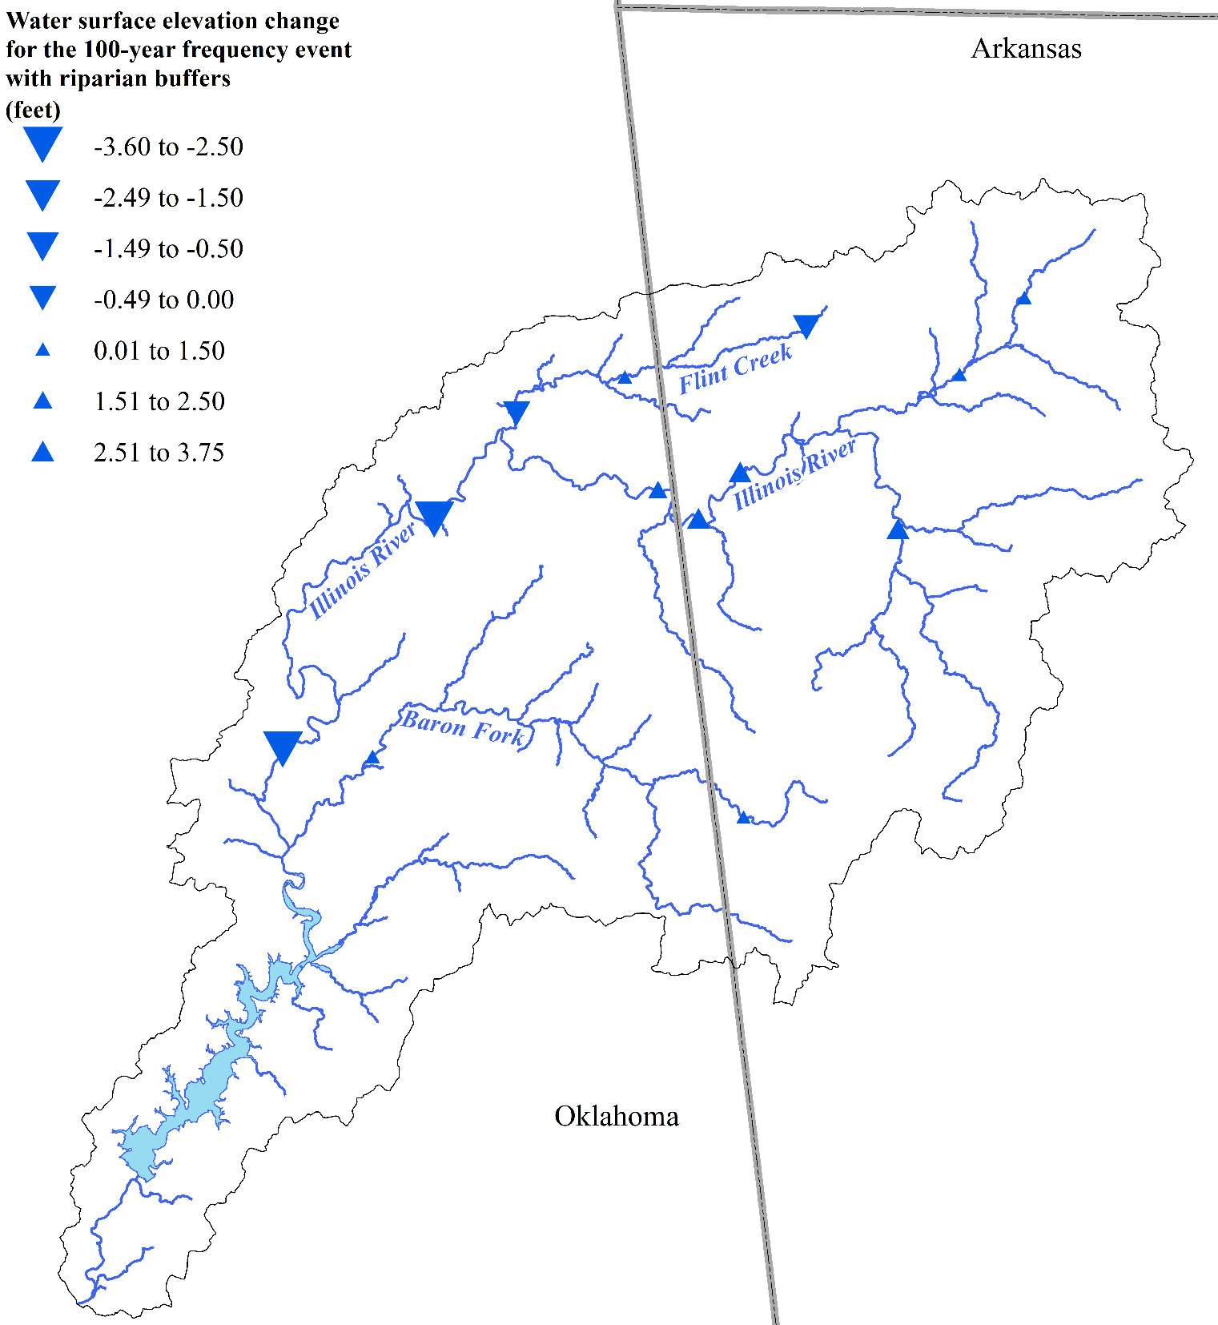
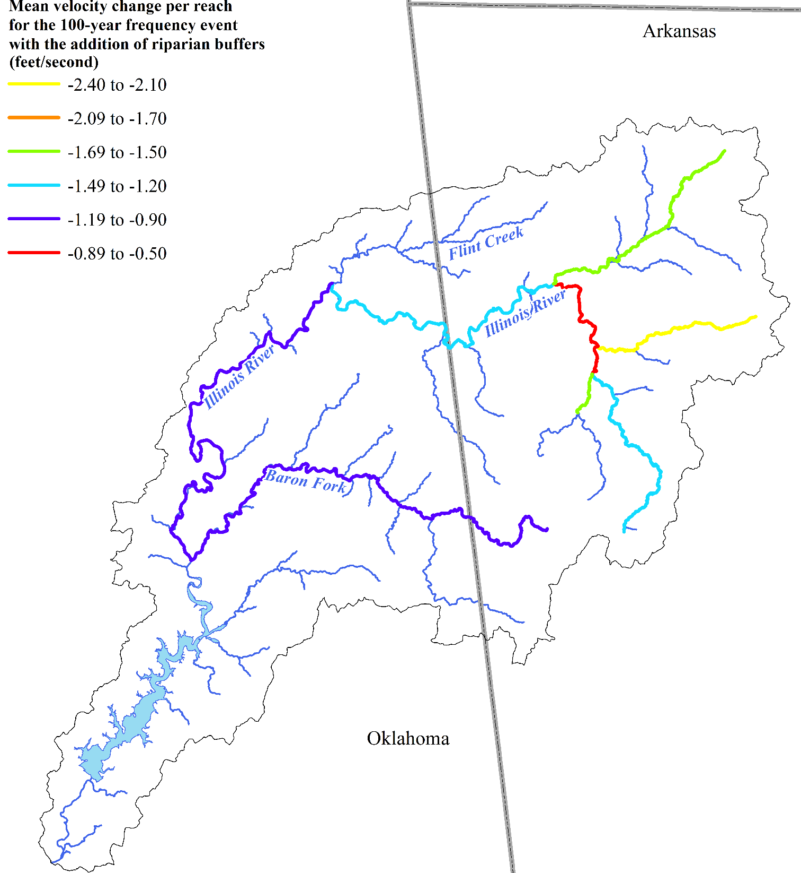
Riparian buffers – 1%AEP (100-Year)

Slide 37
Take-Homes
Not trying to unravel the past but trying to understand how to plan for the future
This information will be used for planning purposes- information to better understand flood risk so that local planners can divide and conquer in their area
Scenarios were simulated to understand the some best management practices at a 30,000 ft view, at a watershed scale
There is localized impact of flooding from urbanization, however we looked at it from a watershed scale, not a really small, local scale
Increase in precipitation, increase in urbanization in NW AR and land-use change along the River in OK – All contributions to flooding with the largest being the increase in precipitation

Slide 38
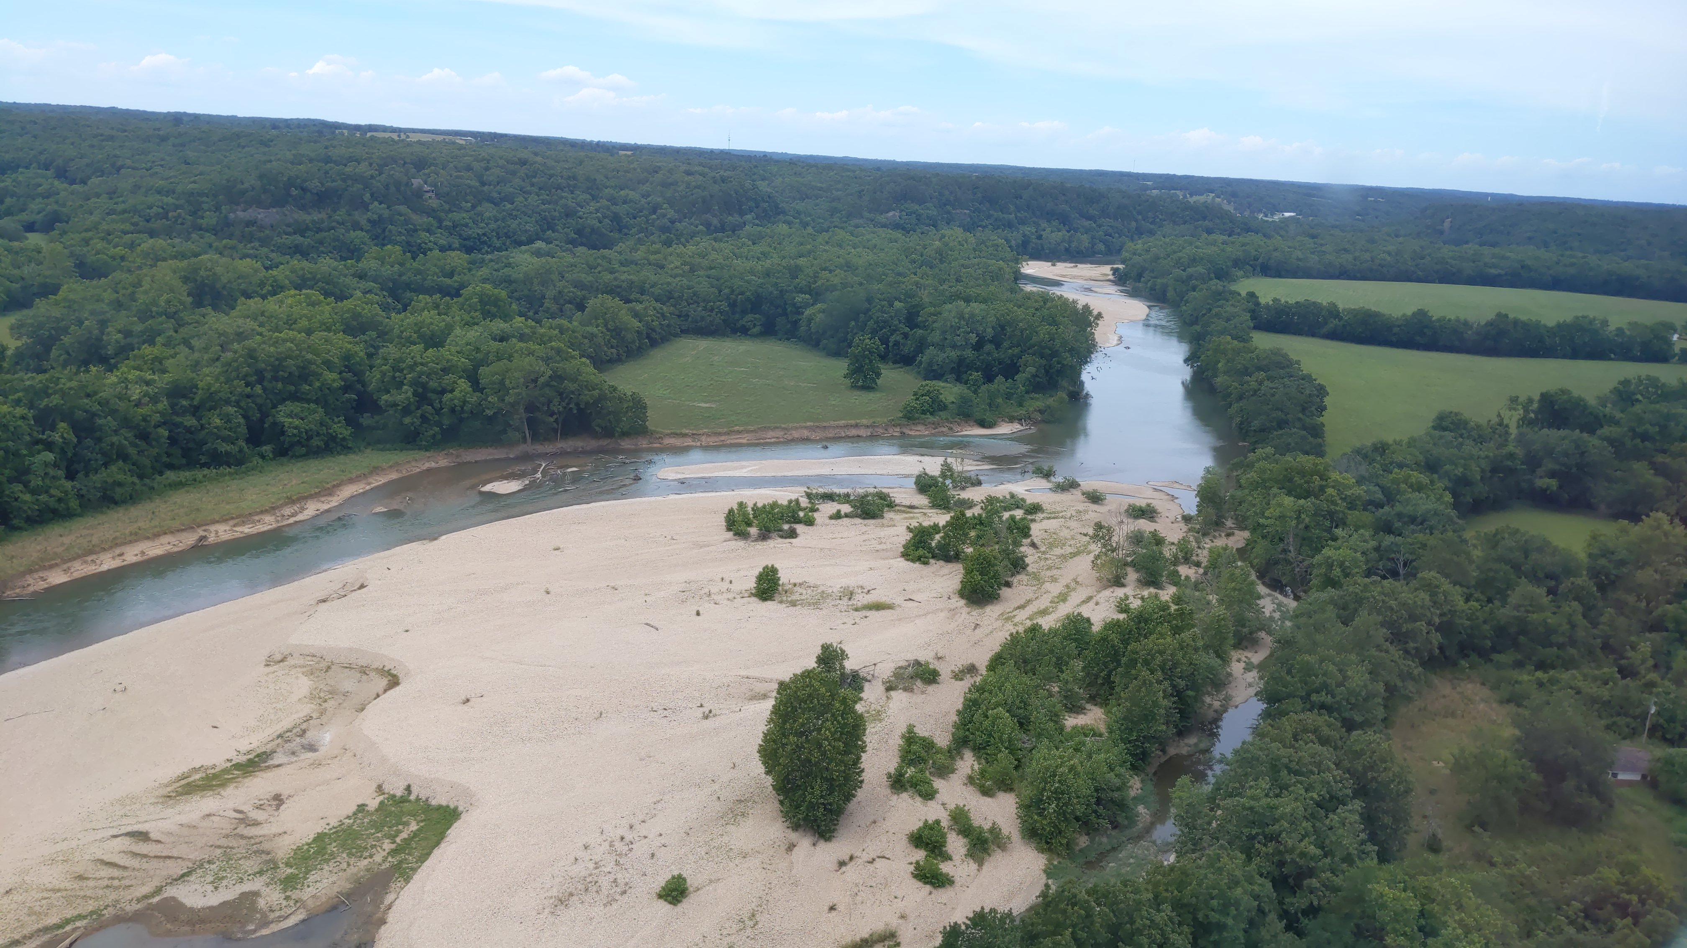
Breakout

Slide 40
Peak Comparisons (Illinois River near Tahlequah)
Scenario/Event | Land Use | Precipitation | Peak Streamflow (cubic feet per second) | Peak Stage (elevation in feet)
2-year Frequency Event | 2016 NLCD | 2-year Frequency Event | 32,439.3 | 683.5
2-year Frequency Event w/Riparian Buffers | 2016 NLCD | 2-year Frequency Event | 27,293.6 | 682.7
5-year Frequency Event | 2016 NLCD | 5-year Frequency Event | 53,079.0 | 686.5
5-year Frequency Event w/Riparian Buffers | 2016 NLCD | 5-year Frequency Event | 41,235.3 | 685.4
10-year Frequency Event | 2016 NLCD | 10-year Frequency Event | 70,324.1 | 689.0
10-year Frequency Event w/Riparian Buffers | 2016 NLCD | 10-year Frequency Event | 53,547.5 | 687.5
25-year Frequency Event | 2016NLCD | 25-year Frequency Event | 96,216.7 | 692.1
25-year Frequency Event w/Riparian Buffers | 2016 NLCD | 25-year Frequency Event | 71,897.6 | 690.3
50-year Frequency Event | 2016 NLCD | 50-year Frequency Event | 117,495.3 | 694.4
50-year Frequency Event w/Riparian Buffers | 2016 NLCD | 50-year Frequency Event | 87,617.2 | 692.4
100-year Frequency Event | 2016 NLCD | 100-year Frequency Event | 139,794.5 | 696.9

Slide 41
Peak Comparisons (Illinois River near Tahlequah)
Scenario/Event | Land Use | Precipitation | Peak Streamflow (cubic feet per second) | Peak Stage (elevation in feet)
100-year Frequency Event w/Riparian Buffers | 2016 NLCD | 100-year Frequency Event | 104,545.8 | 694.3
100-year Frequency Event w/B2 Land-use Scenario | 2050 SRES B2 | 100-year Frequency Event | 147,911.8 | 697.4
100-year Frequency Event w/B2 Land-use Scenario and Detention Basins | 2050 SRES B2 w/Detention Basins | 100-year Frequency Event | 107,826.7 | 693.1
100-year Frequency Event w/A1B Land-use Scenario | 2050 SRES A1B | 100-year Frequency Event | 153,017.8 | 697.7
100-year Frequency Event w/A1B Land-use Scenario and Detention Basins | 2050 SRES A1B w/Detention Basins | 100-year Frequency Event | 112,189.3 | 693.4
April 2017 Validation Event | 2016 NLCD | April 2017 Event | 110,557.7 | 694.1
0 Percent Less Developed | 0% Impervious Values | April 2017 Event | 107,678.7 | 693.7
75 Percent Less Developed | 75% 1990 Impervious Values | April 2017 Event | 108,113.9 | 693.9
B2 Land-use Scenario | 2050 SRES B2 | April 2017 Event | 116,030.2 | 694.6
B2 Land-use Scenario w/Detention Basins | 2050 SRES B2 w/Detention Basins | April 2017 Event | 89,476.5 | 691.5
A1B Land-use Scenario | 2050 SRES A1B | April 2017 Event | 118,933.1 | 694.9
A1B Land-use Scenario w/Detention Basins | 2050 SRES A1B w/Detention Basins | April 2017 Event | 92,237.7 | 691.8

Slide 42
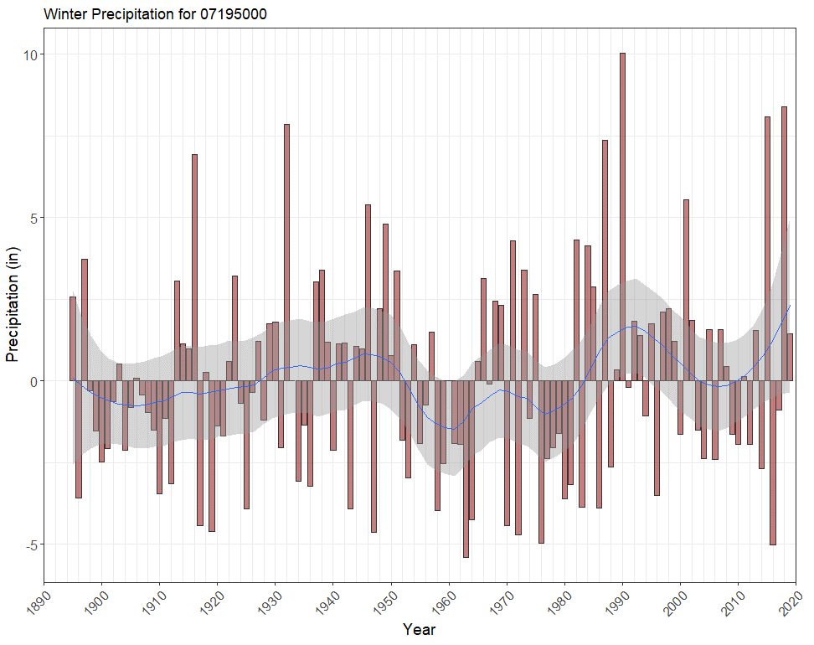
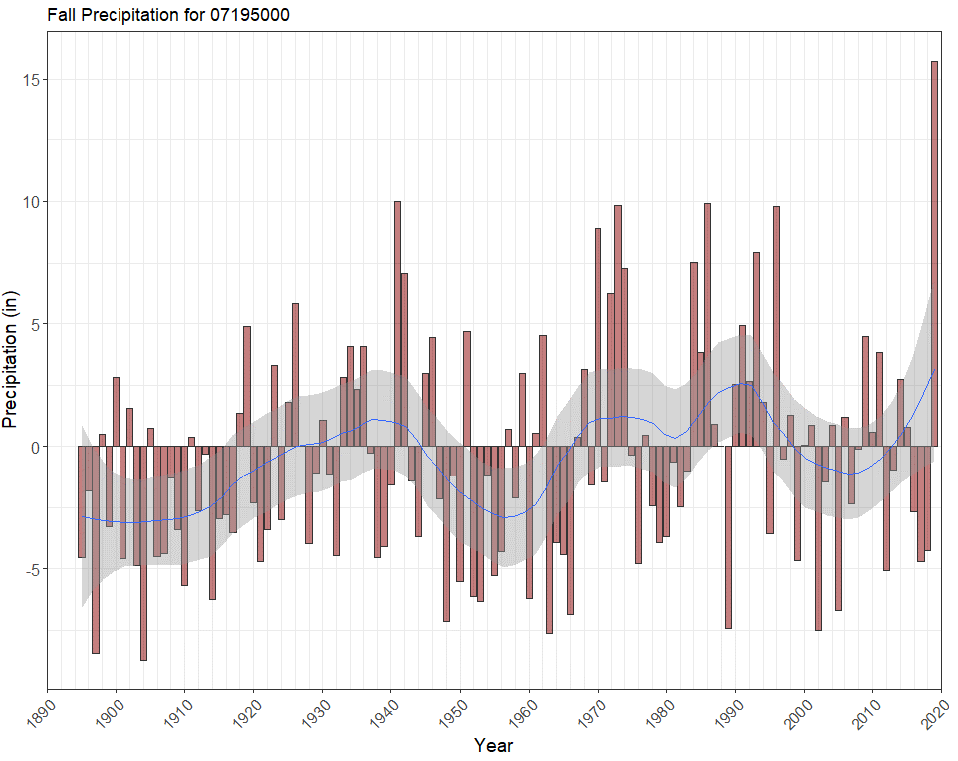
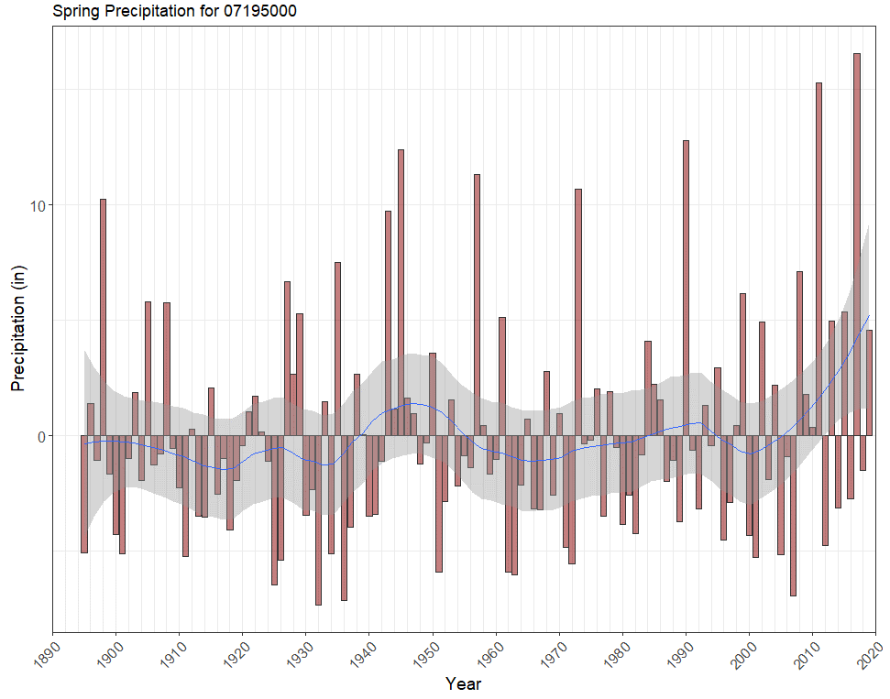
Osage Creek near Elm Springs, AR
PRISM Climate Group

Slide 43
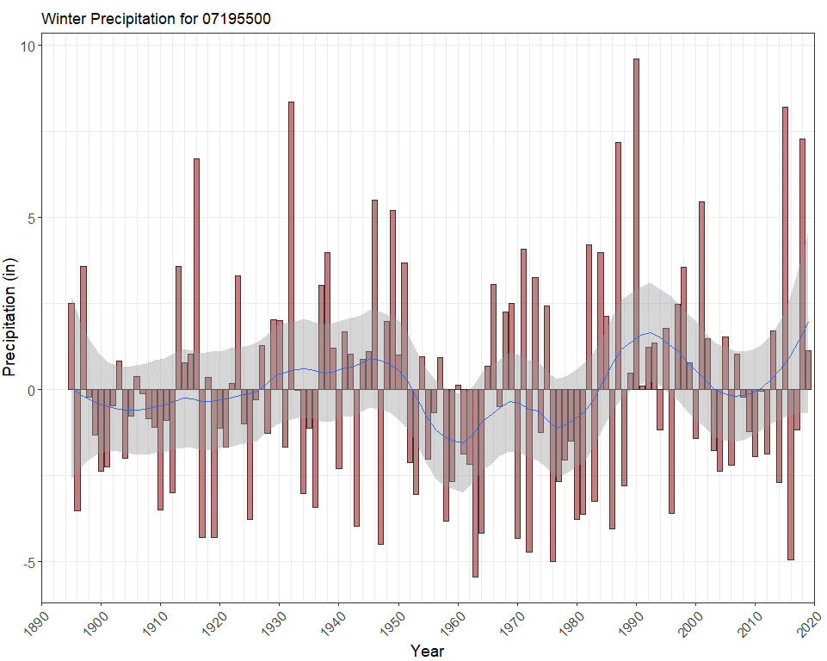
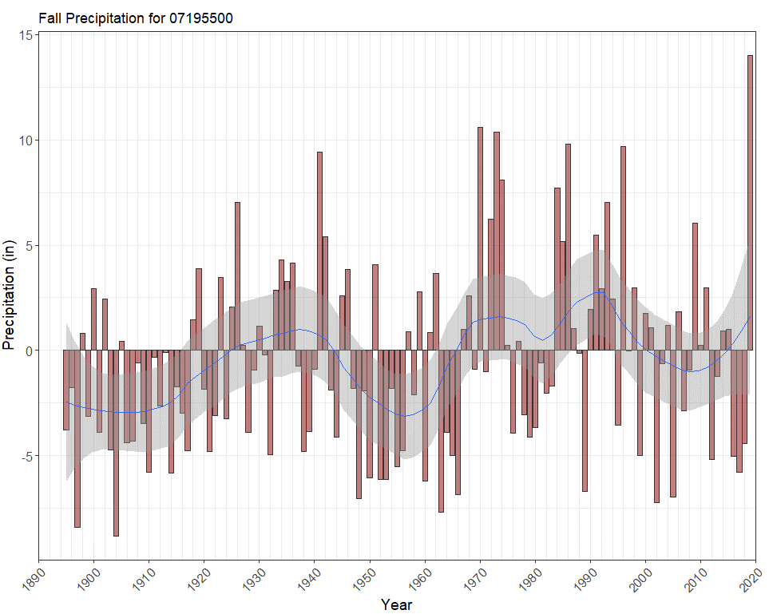

Illinois River near Watts, OK
PRISM Climate Group

Slide 44



Illinois River near Tahlequah, OK
PRISM Climate Group

