Slide 1

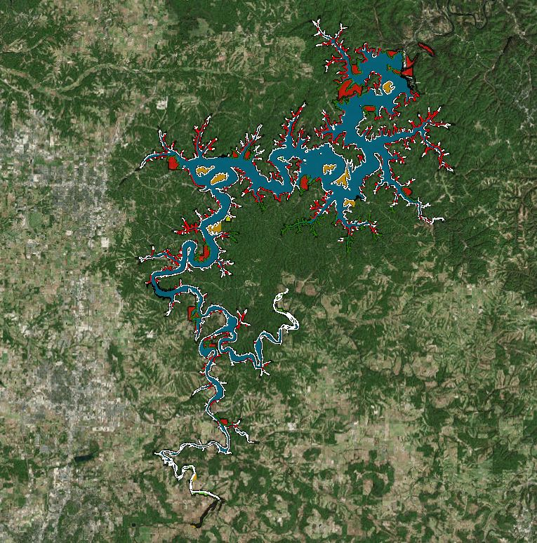
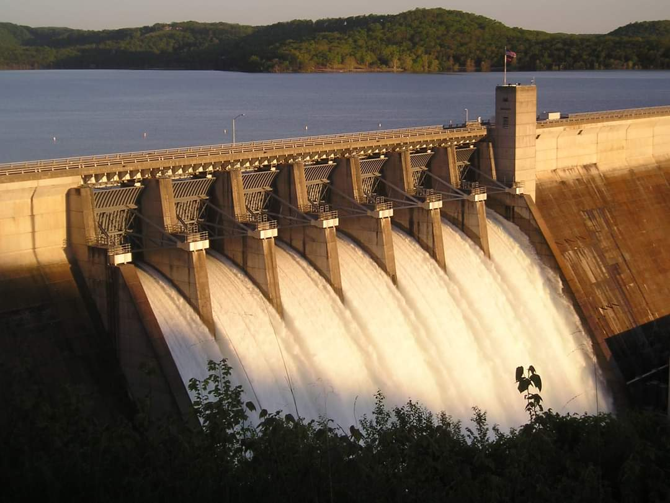

PROPOSED BEAVER LAKE Real Estate Land Acquisition PROJECT
Public comment
Presentation
U.S. Army Corps of Engineers
Little Rock District
Beaver Lake
May 3, 2021
BUILDING STRONG®
and Taking Care of People!
Notes:
On behalf of the US Army Corps of Engineers – Little Rock District and the Beaver Lake Project Office, welcome to the Public Involvement Presentation for the Proposed Beaver Lake Land Acquisition Project at Beaver Lake. As the country is responding to the COVID-19 outbreak, public meetings and workshops which accompany these projects have been cancelled for public safety. The presentation you are viewing is the alternative to the Corps hosting face-to-face public meetings or workshops.
This proposed land acquisition will address inundation in low lying areas around Beaver Lake, as supported by frequent observations, hydraulic modeling, and Real Estate mapping by the Little Rock District.

Slide 2
Purpose of Presentation
Inform the public and stakeholders about the Beaver Lake Land Acquisition project
Define the Beaver Lake Design Memorandum and Supplement
Describe framework of the Beaver Lake Design Memorandum
Describe the land acquisition process
Provide instructions on how to participate in the public comment process
Encourage participation
Provide links to documents
Notes:
The purpose of this presentation is to inform the public and stakeholders that land acquisition planning has started at Beaver Lake to address the inundation of privately-owned land in low lying areas around the lake and seek public input. This presentation provides information on the planning process underway, details on the framework of the proposed land acquisition, describes how the acquisition process would work, provides links to documents and details about how to contact the Corps to ask questions, and provides instructions on how to participate in the process, and encourage participation.
The information provided through public and stakeholder comments is essential to ensuring we are in compliance with the National Environmental Policy Act or NEPA. NEPA is required to ensure federal agencies give proper consideration to the environment prior to undertaking a federal action. Scoping during NEPA involves the public in the decision-making process, while documenting the process by which federal agencies make informed decisions.
Public participation is critical to the success of this important project as it includes the public in the decision-making process. In compliance with the National Environmental Policy Act (NEPA), the information provided through public and stakeholder comments ensures that federal agencies consider impacts to the natural, cultural, and social environment prior to undertaking a federal action.
The NEPA process provides the public with the opportunity to ask questions and comment on the potential impacts of proposed federal actions. It also includes comments from other federal, state and local governments, and Tribal Nations.
The Corps wants your ideas and comments. After watching this presentation, review the other material on the project website and send in comments and participate in the proposed future acquisition process for Beaver Lake.

Slide 3
Presentation Topics
What is the Design Memorandum?
What are fee and flowage?
When would this occur?
Who can I talk to about the plan?
Whose property may be affected?
What would be the process?
Why is a change needed?
How would I be compensated?
Notes:
Topics to be covered in this presentation are summed up under these questions that are often asked in a public meeting or workshop:
What is the Design Memorandum?
Why is a change needed?
What are fee and flowage?
Whose property may be affected?
What would be the process?
How would I be compensated?
Who can I talk to about the plan?
When would this occur?
Under each of these topics, this presentation will provide details to help you better understand the proposed land acquisition project and your role in the process.

Slide 4
What is the Design Memorandum?
The Beaver Lake Real Estate Design Memorandum (REDM) identifies all land and interests in land that would be necessary for the operation, maintenance, and control of the reservoir
The REDM was generated in support of the construction of Beaver Reservoir, which was authorized for flood control, power, and other purposes by the Flood Control Act of 1954, approved 3 September 1954 (Public Law 780, 83rd Congress, 2nd Session), as recommended by the Chief of Engineers in House Document No. 499, 83rd Congress, 2nd Session (referred to as the project document)
The fee acquisition line, as a general rule, was blocked out along regular land subdivision or property ownership lines with the intent of including all lands below elevation 1128 ft. msl and lands required for public access areas
Flowage easements were intended to be acquired to elevation 1135 ft. msl or up to elevation 1148 ft. msl on the White River and up to elevation 1144 ft. msl on War Eagle Creek
Notes:
You might be wondering, what is a Design Memorandum?
The Design Memorandum for Beaver Lake outlines the purpose of the lake and which areas are necessary for its operation, maintenance, and control of the reservoir. It is a document approved by Congress which not only authorizes the project but also specifies how it will operate.
The original Design Memorandum was for an Eisenhower Era Lake, which authorized the minimum amount of land required for the operation of the lake. For example, The fee acquisition line was generally blocked out along regular land subdivision or property ownership lines to include all lands below elevation 1128 ft. mean sea level or to include the lands required for public access areas.

Slide 5
Why is a change needed?
Because of the terrain, the blocking out process did not encompass all lands required for the project in many places; the original acquisition effort to acquire land for Beaver Lake fell short of meeting the designed requirement
In areas currently owned by roughly 500 landowners, Beaver Lake floods privately-owned land at seasonal conservation pool or flood pool
In an effort to address the designed operation of Beaver Lake, the Corps of Engineers is reviewing site specific data at various locations where water routinely inundates privately-owned land
A Beaver Lake Real Estate Design Memorandum – Supplement (REDM-S) has been generated that would address these concerns should the decision be made to acquire property
Notes:
So why is a change needed to the design memorandum?
In the simplest terms, Eisenhower-Era lakes acquired the minimum amount of land required for the lake’s operation. Additionally, the blocking out process led to acquisition of land based on the boundaries of contemporary landowners. It did not follow the exact elevation contour at 1128’.
What we have found is that smaller segments of land (belonging to roughly 500 landowners), tend to flood at seasonal conservation pool and flood pool. Since the lake management may flood these privately owned lands, it is important to acquire these areas and compensate the landowners for this property.

Slide 6
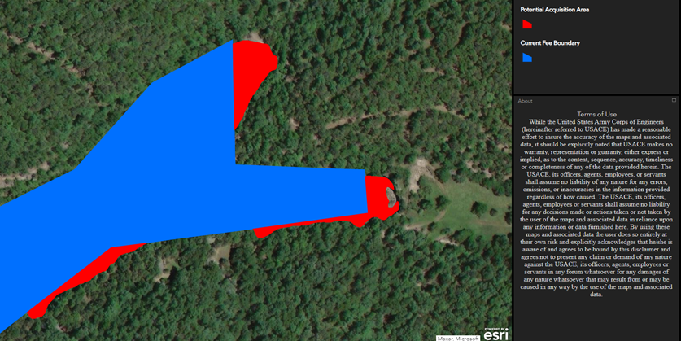
Why is a change needed?
Below: One of the identified acquisition areas as part of the first round of proposed acquisitions
Current boundaries are overlaid on the map (right) to demonstrate the proposed changes
The current fee area (in blue) illustrates how the land was initially acquired in 1954, and how the “blocked” nature of the fee does not correspond to the contour of the lake and the associated flooding
Notes:
To illustrate how the property boundaries around the lake currently exist, note the image in this slide.
In this specific area of Beaver Lake, you can see how the “blocked” nature of the existing fee boundary does not accurately follow the actual contour of the lake.
The area depicted here is a portion of the overall map available on the project website for closer review.

Slide 7
What are fee and flowage?
Fee acquisitions include the purchase of land and the subsequent transfer of property owners
Flowage acquisition allows the property owner to retain ownership of the land but conveys to the government the right to occasionally flood and restrict construction of structures without approval
Fee acquisition is the primary effort for this project
Analysis conducted for the REDM-S identified primarily fee acquisition is needed in certain areas up to 1128 ft. msl
A small amount of flowage acquisition may be necessary
These elevations are in accordance with the original REDM and will follow the elevation contour, instead of the blocked-out survey
Notes:
What are fee and flowage?
Fee and flowage are the two types of land acquisitions that would be performed as part of this project. Fee will involve the direct purchase of land with a transfer in property owners, while flowage would authorize occasional flooding of that property, known as a flowage easement. Flowage would also restrict construction on these areas, knowing that they would be damaged or inundated by water if constructed.
Should land acquisition prove necessary, the Corps would only purchase fee and flowage in accordance with the previous congressionally authorized elevations outlined in the original design memorandum. Most of these acquisition activities would involve fee acquisitions, however, land surveys may dictate the need for a small amount of flowage easements.
These surveys would need to be performed to ensure we identify and acquire only the lands that meet this requirement and need.

Slide 8
Whose property may be affected?
Currently, the Little Rock District Corps of Engineers estimates roughly 500 impacted landowners
Our first priority would be to acquire land that is routinely inundated or for which we have received public complaint
Current and future funding allocations would dictate the land acquisition schedule
Notes:
After reviewing hydraulic modeling data, generating GIS maps of the area, and focusing on areas of landowner concern around Beaver Lake itself, the Corps has identified approximately 500 impacted landowners with land that meets the requirements for acquisition.
After our planning and analysis process, and NEPA evaluation is completed, if a decision is made to proceed with acquisitions, the Corps would start land acquisition activities in the areas routinely inundated or for which we have received public complaint.
As with any project, our current and future Fiscal Year funding would dictate a land acquisition schedule. e land

Slide 9
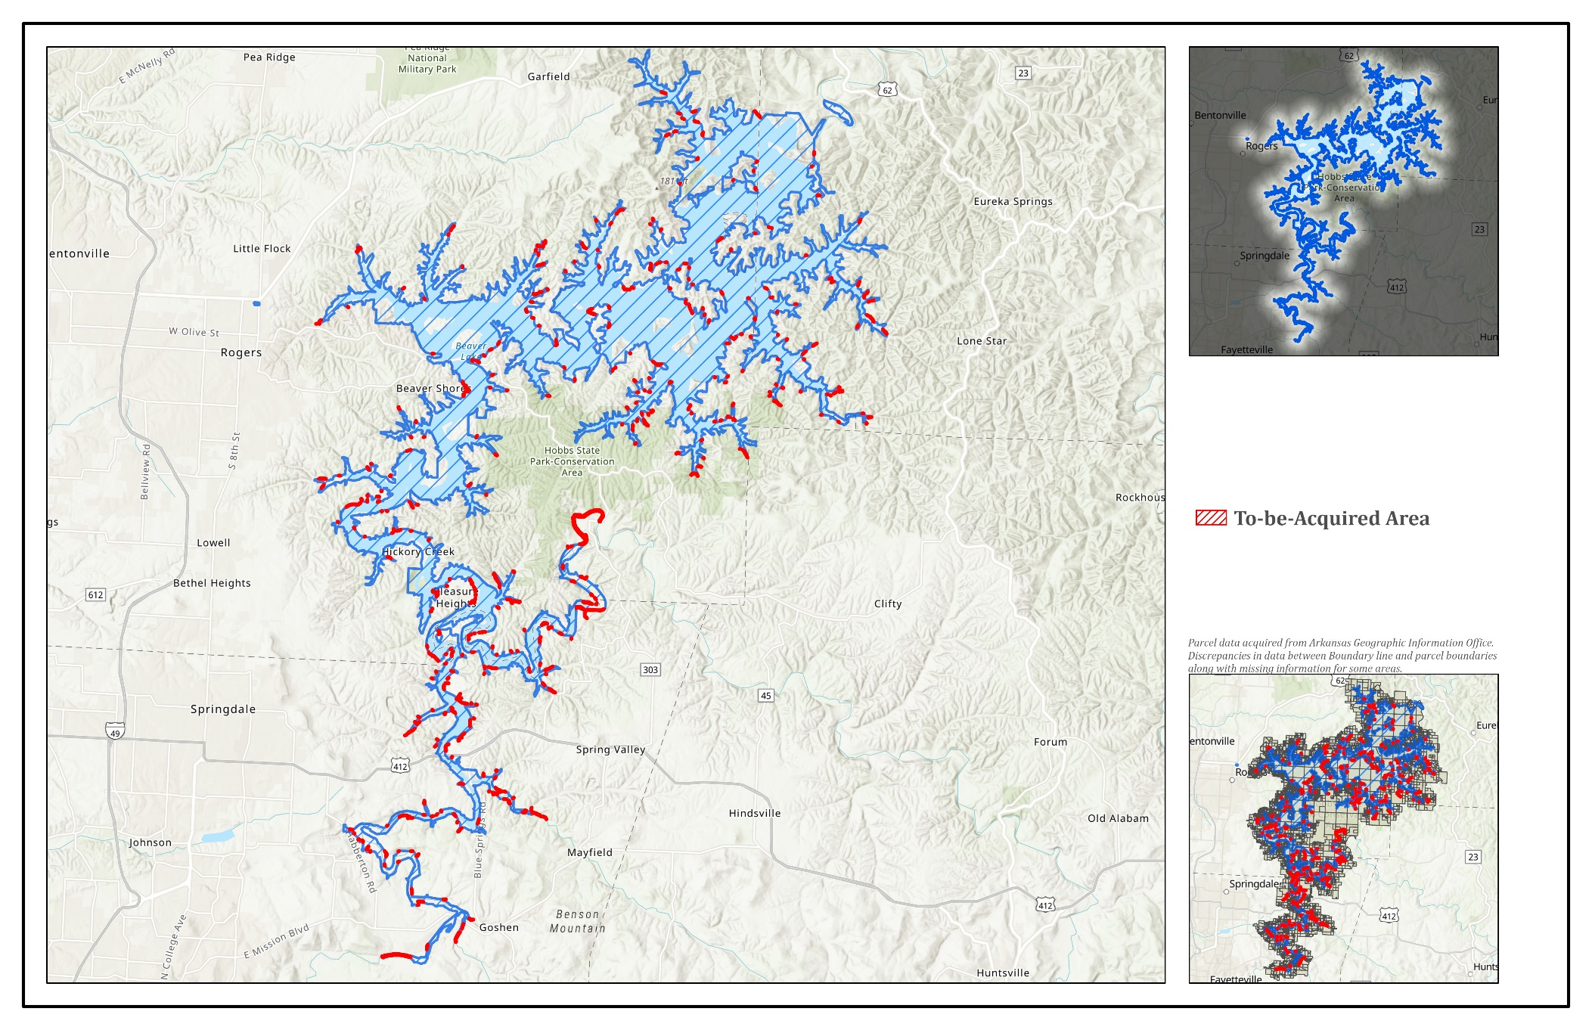
Whose property will be affected?
Whose property may be affected?
A complete interactive map of the identified areas is available at:
https://www.swl.usace.army.mil/Missions/Real-Estate/Beaver-Lake-Land-Acquisition/
Only areas in red meet the requirements for potential acquisitions
Current and future acquisition will be subject to funding
Notes:
An overall map of the proposed areas for acquisition can be found on the Little Rock District webpage indicated at the top of this slide.
This is an interactive GIS map that can be best viewed in a google chrome browser.
In this map, areas that meet the criteria for acquisition are outlined in red. Acquisition of these areas would be based on negotiations and available funding,

Slide 10
What would be the process?
Right of Entry (ROE) permits will be sent out to landowners as applicable for the first step of the NEPA process
Through the ROE, the Corps of Engineers is requesting permission to enter the property in order to conduct required environmental surveys and potentially traditional land surveys (at no cost to the landowner)
An external appraiser would then estimate the value of the property
If applicable, the Corps of Engineers would acquire the land as funding will allow
Notes:
We have released a Corps of Engineers media notice to the surrounding community and are also sending out Right of Entry (ROE) permits to affected landowners. The media release aims to inform the community of our project goals while the Right of Entry permits are required for our employees and contractors to conduct environmental surveys for NEPA and potentially boundary line surveys, if approved. These surveys will not damage or alter your property in any way and will be performed by licensed professionals at no cost to the landowners.
Additionally, a professional, external appraiser would then estimate the value to the affected land. These appraisers would be non-government employees, contracted to perform an appraisal of the affected property. These appraisers are professionals who are bound by their licensing to ensure they accurately portray the property’s fair market value.
Following the surveys and appraisals, the Corps of Engineers real estate team from the Little Rock District would begin contacting landowners to negotiate for fee and flowage easements.

Slide 11
How would I be compensated?
The external appraiser would determine the fair market value of the land
Negotiations would occur between the Corps of Engineers and the landowner
Eminent domain through condemnation is authorized, however would only be used if negotiations through other means are unsuccessful
All land acquisitions would be in compliance with the Uniform Relocation Act and federal land acquisition law
Notes:
After the external appraiser determines the fair market value of the property in question, negotiations would begin with the landowner and the real estate team. The real estate team would facilitate the negotiations and the acquisition process, ensuring the property owner is offered fair market value. All efforts would be made to come to a mutual agreement during the negotiations, however condemnation may be used if negotiations through other means are unsuccessful.

Slide 12
Who can I talk to about the plan?
Questions about this project can be addressed by:
Beaver Lake Project Office at:
Phone: (501) 340-1230 or (501) 340-1702
- OR -
Email: CESWL-BeaverLakeAcquisitionPublicComment@usace.army.mil
**Please note that official public comments for the NEPA public comment period must be in writing via the e-mail inbox, website provided, or regular mail.
Notes:
If you have questions regarding this project, please call or email us at these points of contact.
You can also send questions to the Email address setup for this project as listed on this slide.
**Please note that official public comments for the NEPA public comment period must be in writing via the e-mail inbox, website provided, or regular mail.

Slide 13
When would this occur?
The surveys and preparatory work would take around 12 months to complete for the entire area, but may be broken up into several areas based on priority or urgency
The entire project itself would take course of the next several years, contingent on available funding for acquisition
Notes:
This project would occur over the next several years, contingent on available funding for acquisition.

Slide 14
Thank you for viewing this presentation and participating in the public comment period for the Beaver Lake Real Estate Land Acquisition
Send comments to:
Email:
CESWL-BeaverLakeAcquisitionPublicComment@usace.army.mil
or utilize the embedded comment form in the website below
Website address:
https://go.usa.gov/xsQyt
or
https://www.swl.usace.army.mil/Missions/Real-Estate/Beaver-Lake-Land-Acquisition/
Notes:
Thank you for viewing this presentation and participating in the public comment period for the Beaver Lake Land Acquisition project.
Project documents are available at this website.
Please send your comments to this email address or utilize the embedded comment form on the website.

Slide 15
You may also mail your comments to the
Little Rock District Office- Real Estate Division:
ATTN: Chief, Real Estate Division
P.O. Box 867, Little Rock, AR 72203
Please include at least a name and return address with your comment, so that we may properly log and address your concerns
You may also download and print the comment form from our website
Comments missing this information may not be recorded as official comments for our public comment period
Notes:
Alternatively, if you would like to mail your comments, please utilize the address listed here.
Please ensure you include sufficient information so that we may incorporate and respond to your comments or concerns.
Thank you.

