Slide 1
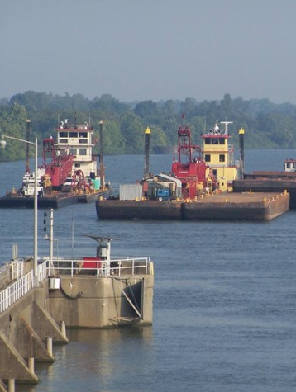
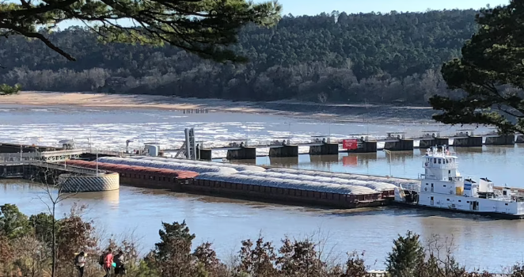
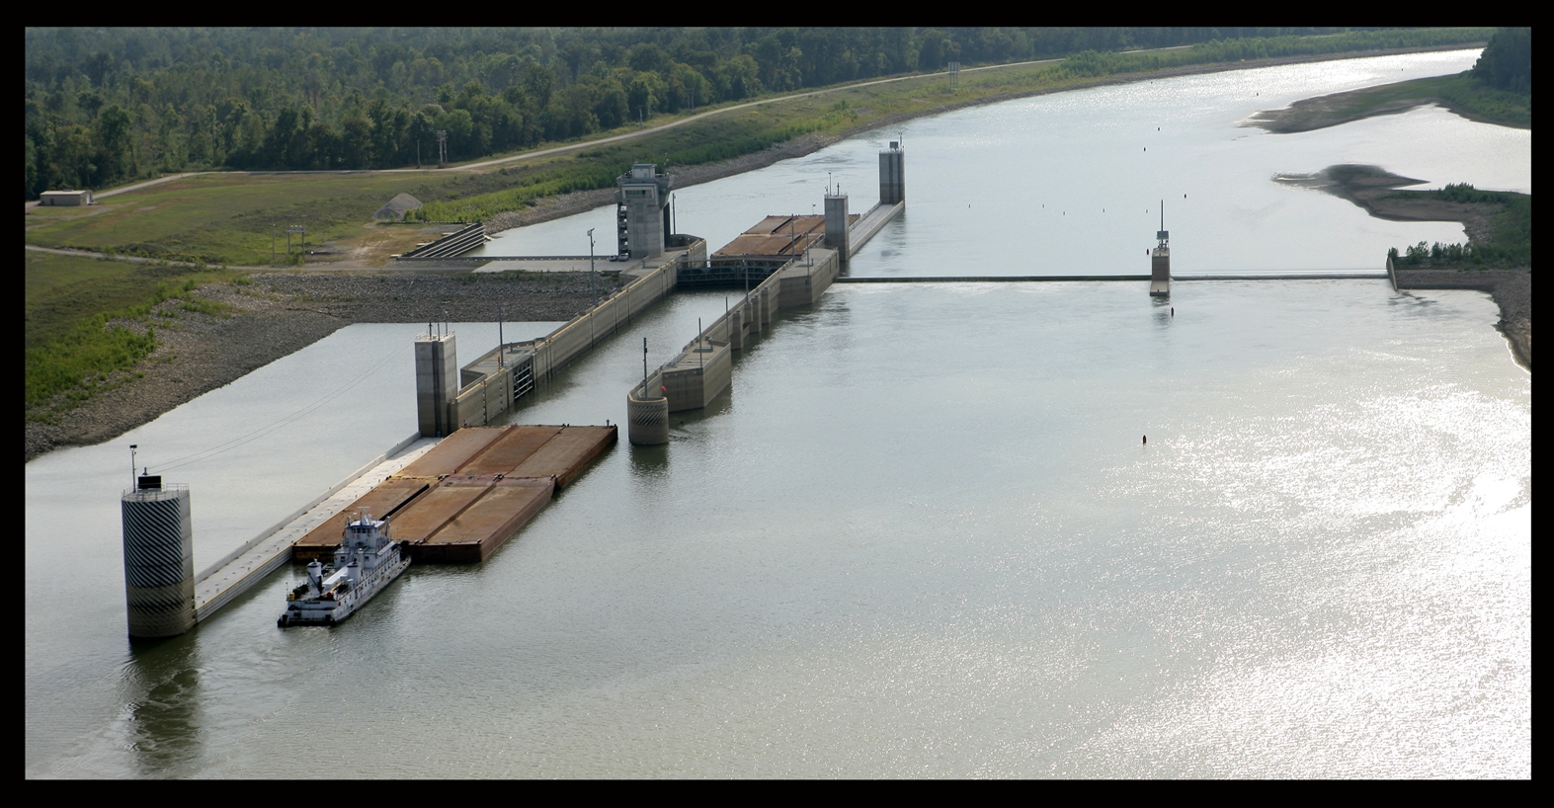
McClellan-Kerr Arkansas River Navigation System 12-Foot Channel
Public Engagement Workshop
June 5, 2023 – Tulsa, OK
June 6, 2023 – Fort Smith, AR
June 7, 2023 – Little Rock, AR
June 8, 2023 – Pine Bluff, AR

Slide 2
Environmental Assessment Guidelines and
the National Environmental Policy Act (NEPA) Process
What is NEPA?
One of the oldest environmental laws, it requires Federal agencies to consider and disclose the environmental and social effects of their proposed actions in a publicly available document.
Why a Supplemental Environmental Assessment?
We are preparing a SEA to update the 2005 Environmental Impact Statement to ensure compliance with all applicable environmental laws.
An Environmental Assessment fully discloses the Purpose and Need, Alternatives Considered, Baseline Conditions, and the Environmental and Social Effects.

Slide 3
MKARNS 12-Foot Channel
What is it?
Authorized under Section 136 of the Energy and Water Development Appropriations Act of 2004, the MKARNS 12-Foot Channel purpose is to improve commercial navigation operation by deepening the current 9-foot navigation channel to a 12-foot operational depth. Over 85% of the MKARNS is already at this 12-foot operational depth.
Why is it needed?
Deepening the channel will allow the existing inland commercial fleet to sail at deeper drafts that are consistent with those on the Lower Mississippi River and load more cargo onto their barges thereby lowering transportation costs. This benefits producers and consumers throughout the region and nation. Roughly $5 billion of goods are moved on the MKARNS annually. In addition, shipping more cargo on the MKARNS versus road or rail may have the added benefit of reducing landside congestion on roads and railways. Lastly, air emissions from barges on ton per mile basis are far less than trucks or rail.

Slide 4
MKARNS History
1946: Rivers and Harbors Act of 1946 authorized development of the AR River and its tributaries for navigation
1952: Construction on the MKARNS began
1999: Arkansas River Navigation Study (ARNS) initiated
2004: Energy and Water Development Act of 2004 authorized project depth of 12 feet
2005: ARNS Feasibility Study and EIS completed, and Record of Decision signed for 12-foot Channel
2020: WRDA 2020 provided funding to initiate updated modeling and designs

Slide 5
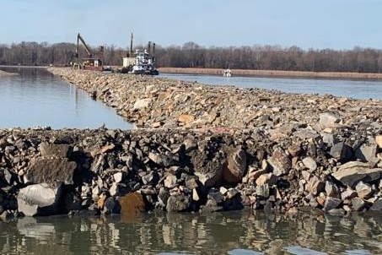
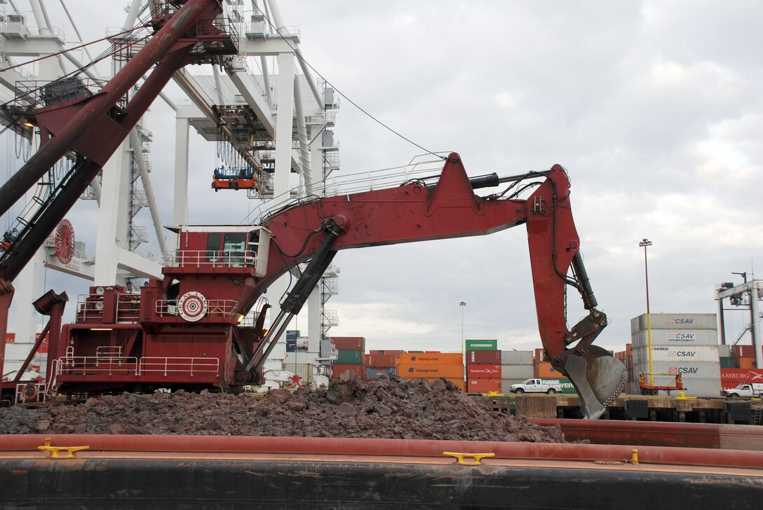
MKARNS 12-Foot Channel Construction Features
Features are designed based on updated hydrologic and sediment modeling done since 2021 and include:
Rock weirs
Dredging
Re-directive or resistive structures that use the river’s energy to deepen and enhance the navigation channel, increase environmental diversity, and maintain system status.
Removal of sediment and debris from the channel to allow ships to pass and maintain river flow.

Slide 6
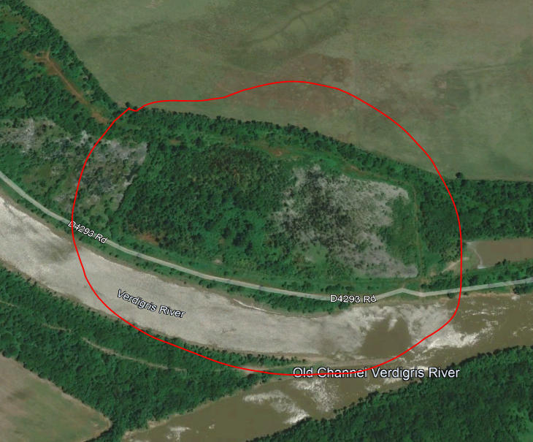
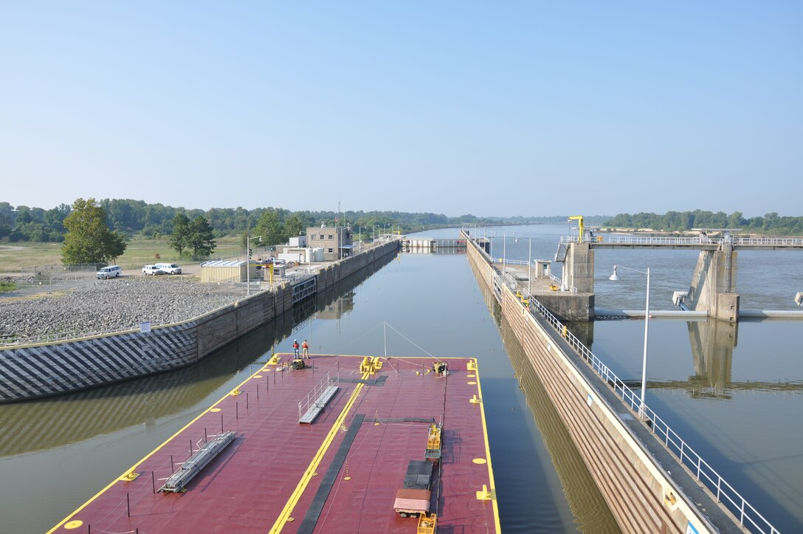
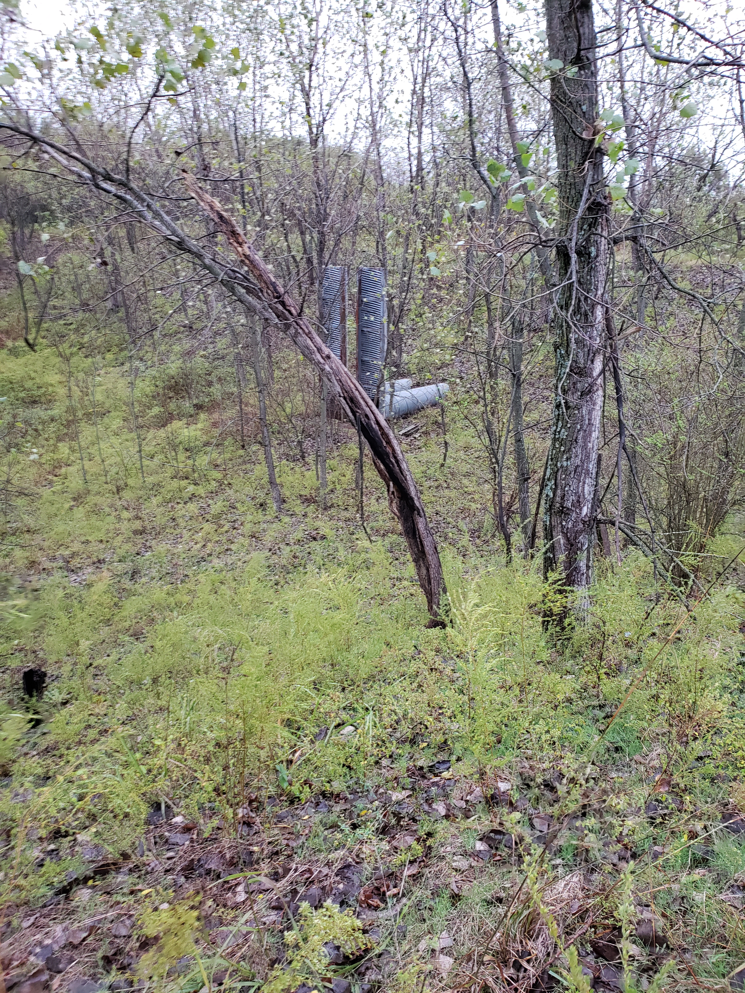
MKARNS 12-Foot Channel Construction Features
Features are designed based on updated hydrologic and sediment modeling done since 2021 and include:
Upland disposal sites
Lock modifications
Disposal sites allow dredge material to be used to improve habitat. Image depicts habitat available after fill placement.
Modifications strengthen locks to accommodate barges with a draft of more than 9ft.

Slide 7
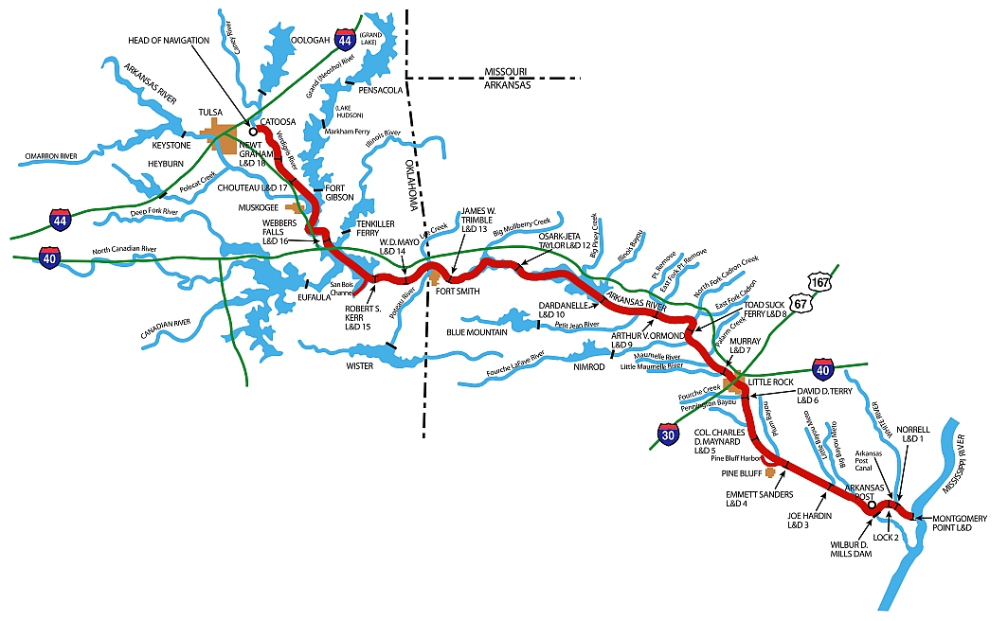
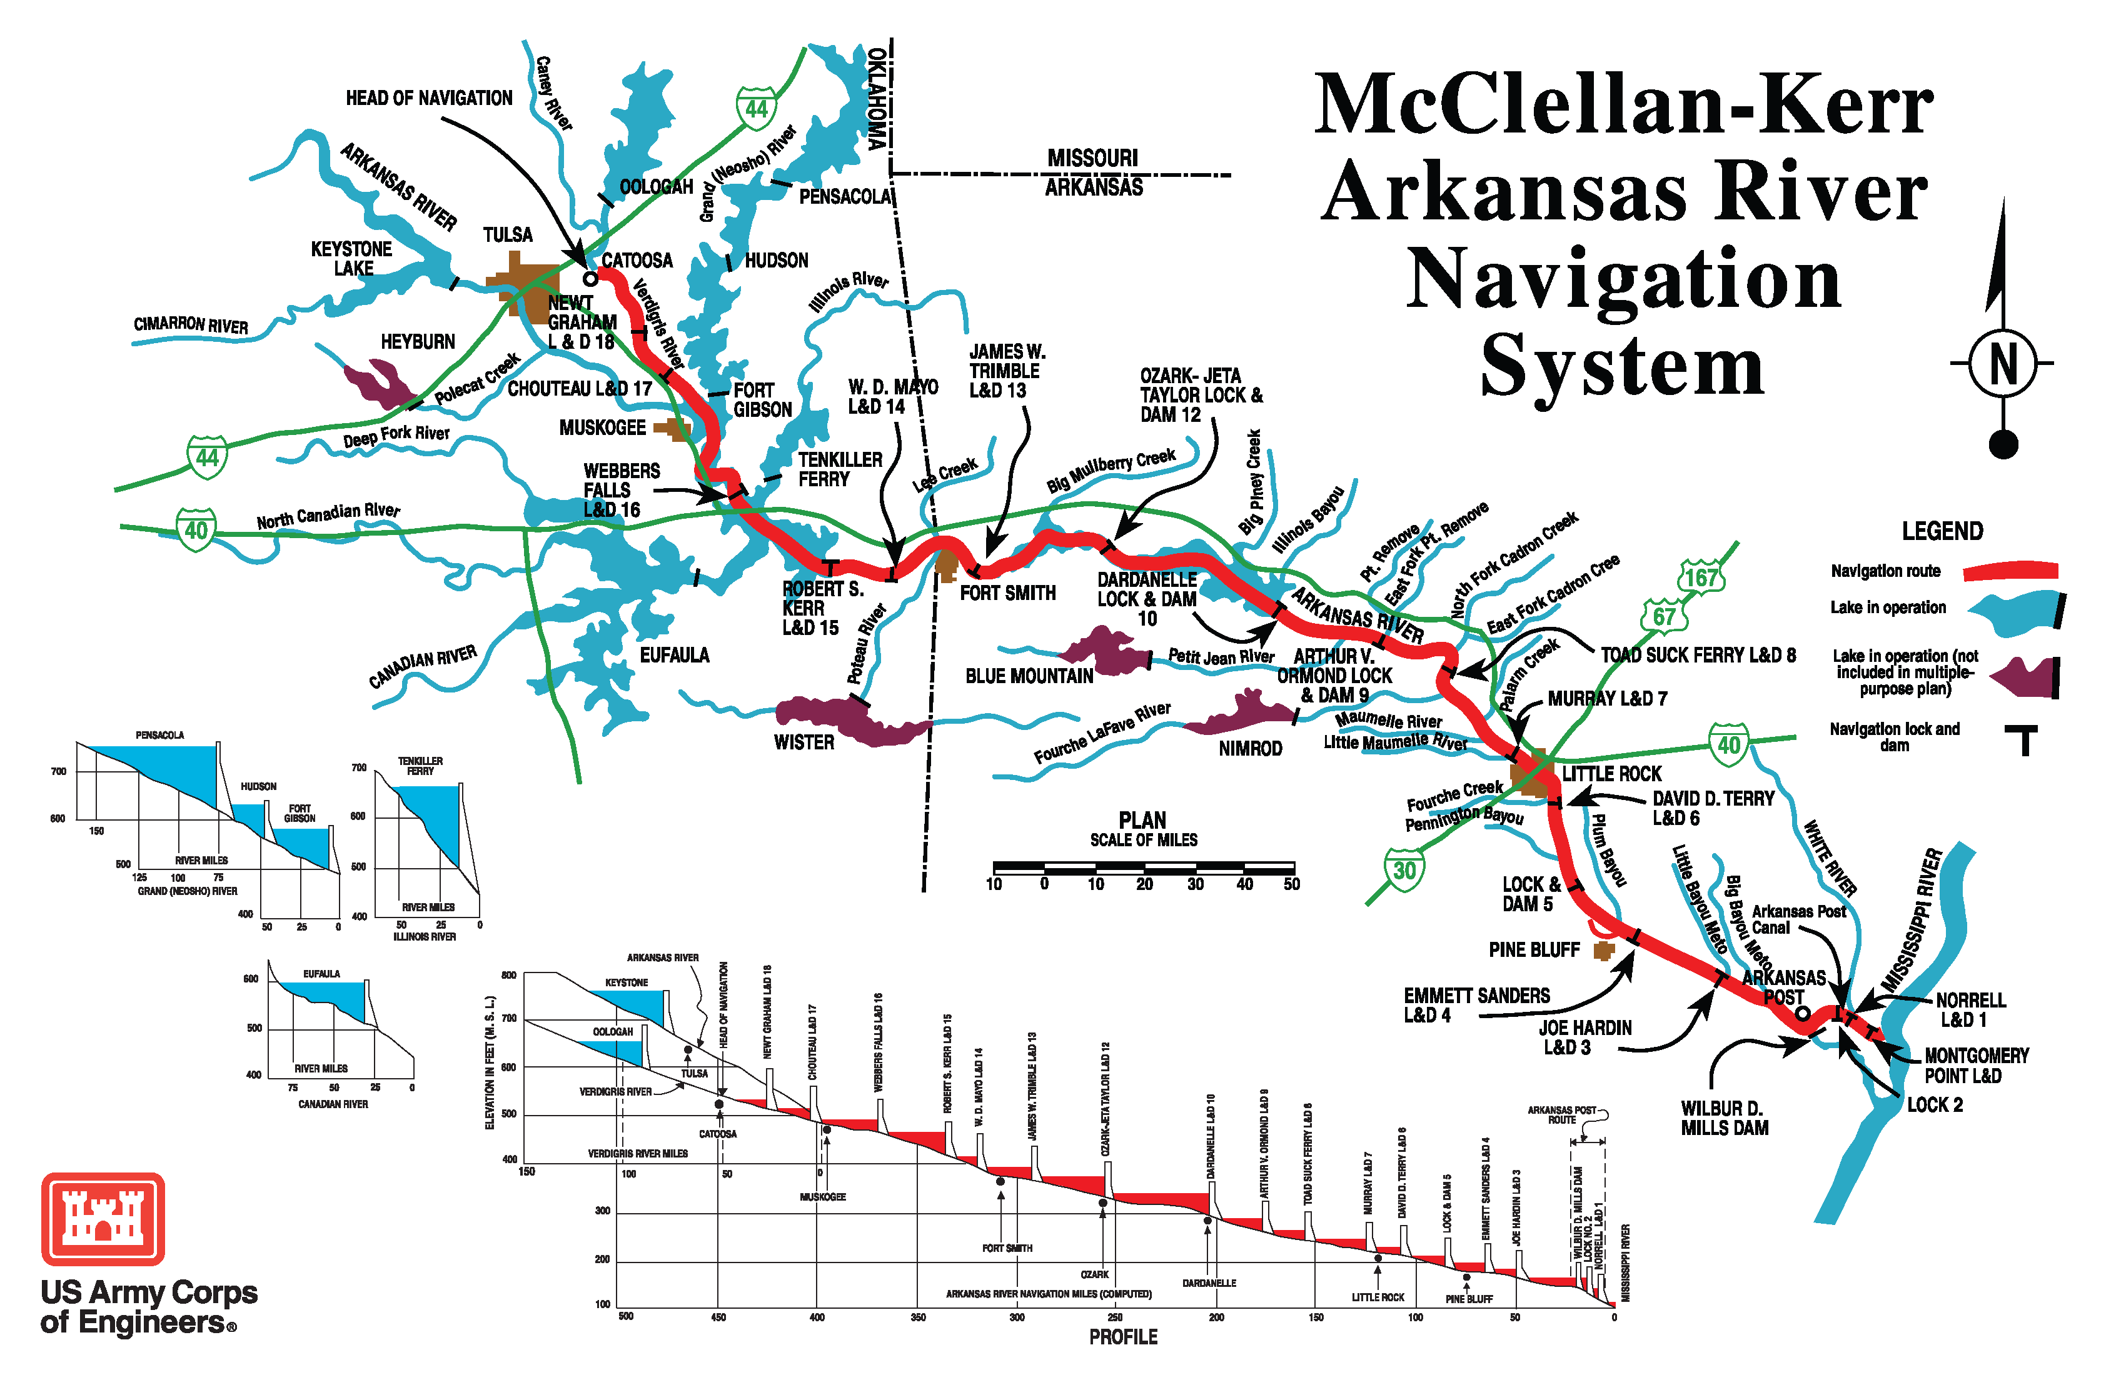
MKARNS Map
McClellan-Kerr Arkansas River Navigation System
LEGEND
Navigation Route
T
Lock & Dam
445-mile-long system with 18 locks and dams

Slide 8
MKARNS 12-Foot Benefits
Increased cargo capacity by deepening the channel
Potentially reduces roadway congestion by allowing more cargo to ship on the MKARNS, rather than using truck and rail routes
Beneficial use options available for dredge material
Deepening the channel will allow the existing inland commercial fleet to sail at deeper drafts that are consistent with those on the Lower Mississippi River

Slide 9
MKARNS 12-Foot Schedule
July 8, 2023
Comment period ends
Late summer or fall 2023
Draft SEA available for review and comment
Late 2023/early 2024
Final SEA available
2025
Construction begins

Slide 10
How Can You Participate?
Today’s Workshop
  Review information on the display boards and handouts
  Ask the USACE Staff questions
  How to Provide Comments (4 options)
    Place comment cards in comment box tonight
    Submit comments online at:
      https://www.swl.usace.army.mil/Missions/Planning/MKARNS-12-foot-Channel/Comment-Card/
    E-mail comments to:
    CESWL-NAV-MKARNS12FOOTCHANNEL@usace.army.mil
      Mail comments to:
      U.S. Army Corps of Engineers
      Attn: Kelly Dobroski (RPEC)
      2000 Fort Point Rd,
      Galveston, TX 77550
Comments must
be postmarked by: July 8, 2023

